Slide 1
Principles of Theater Practices
Module 9 – Business applications

Slide 2
Costs to put on a production
Rights
Director
Designers
Materials
Rehearsal space rent
Performance stage rent
Actors
Technicians
Advertising

Slide 3
Tax exempt (501c3)
Nonprofit
Your business must serve the public good in some way. Nonprofits do not distribute profit to anything other than furthering the advancement of the organization.
For profit
Operates with the goal of making money. Most businesses are for-profits that serve their customers by selling a product or service. The business owner earns an income from the for-profit and may also pay shareholders and investors from the profits.

Slide 4
Rights cost breakdown
Based on a number of factors
Ticket price
Number of performances
Number of seats
How long of run
Example - $10 ticket for 10 performances in a 100 seat house performed over 1 week, estimated rights would be about $2,000
Estimated revenue generated from all performances would be $10,000
Public domain
Plays/musicals whose author has been dead for 95 years (America)
Author’s estate can renew copywrite, preventing entry to public domain
Publish them in a book
Perform them without royalty
Translate the text into “modern English
Write a derivative work
Edit them down in length
Alter the text/characters

Slide 5
Cost to make a basic 4’x8’ flat
Constructed from 1” x 3” x 8’ pine board and lauan
1” x 3” x 8’ boards are $5.60 each
You’ll need 4
Lauan is $17 a sheet
You’ll need 1
Glue and fasteners
Total price is about $40-42

Slide 6
Space rentals
Wilson center Main Stage - $960/day
535 seats
JU’s Swisher theater – $800/day
392 seats
Florida theater - $3,500/day
1900 seats

Slide 7
Union vs Non-union
Union
Equity actors and SM
Ability to work with the big names
Defined working conditions
Defined time allowances
Defined minimum pay rates for most positions
Must have a big budget!
Non-union
Use any non-union actor you want
Hire any crew members you want for what ever schedule and pay rate
Have what ever working conditions you want – short of a hazardous work environment –lawsuits are not your friend!
Can be more cost conscientious

Slide 8
Costs to advertise
Digital billboard $3,100 per month
Local radio starts at $200 per spot
Pandora starts at $1,500 a month
Facebook campaign $0.28 per click
Local TV starts at $5 per 1,000 viewers per 30 sec. spot
Postcard mailers $1,150 per 1000

Slide 9
Costs for ticket platforms
If you want to sell tickets in advance
Staff a box office or setup a phone in system
Must be able to process transactions
Have will call or can mail/email tickets
Eventbrite
2% + $0.79 per sold ticket plus a processing fee of 2.5% per order
Many platforms don’t charge for free events

Slide 10
What about if you want to bring in artists
When you bring in artists/performers, their manager will present a rider
A rider is a document that outlines the requests/demands of the environment in order for the artist to perform – this is contractual
The information in a rider outlines performance area necessities as well as backstage accommodations
Any changes have to be amended prior to accepting the rider from both parties

Slide 11
Artists can be particular
Van Halen – No Brown M&Ms
Van Halen’s 1982 Rider infamously stipulated that under no circumstances were there to be brown M&Ms.
it was recently revealed that this very specific request was included to test whether promoters were reading the rider and contract thoroughly. If the band got to the green room to discover brown M&Ms they knew it was highly likely that another more important detail was missed.
Mariah Carey – Kittens
Mariah Carey has been known to request 20 white kittens and 100 doves. The venue in question did manage to source the doves but fortunately health & safety stepped in to veto the kittens.
Also make sure you’ve got a lift or the green room is on the ground floor – Mariah doesn’t do stairs.

Slide 12
Katy Perry – Mute Driver
Backstage ambiance is very important to Katy Perry.
Her green room is draped in beige or baby pink material and decorated with ornate French standing lamps.
Her rider goes into very specific detail about a few matters; there may be ‘ABSOLUTELY NO CARNATIONS’ in the flower arrangement and the driver ‘will not start a conversation with the client’
Britney Spears – Fish & Chip Supper
In 2011, her rider included a fish & chip supper and a frame photograph of Princess Diana.
McDonalds Cheeseburgers without the buns and 100 figs and prunes were also required.

Slide 13
Eminem
For a 2011 show in Northern Ireland Eminem was very specific about the brands of food and drink he wanted as well as his need for work out gear on site, but the oddest inclusion was the requirement of a Koi Carp pond
Beyoncé
Beyoncé demands her dressing room be kept at 78 degrees and asks for chicken legs "HEAVILY SEASONED" with cayenne pepper and rose-scented candles. And don't have Coca-Cola products anywhere near her — Beyoncé can only be seen with Pepsi products due to a contractual agreement

Slide 14
Getting mor specific
Adele
12 Small bottles still (non-carbonated) spring water (at room temperature)
1 Electric kettle for BOILING water
6 Large mugs for tea. All mugs should be new, washed and dried.
6 metal teaspoons
2 "Squeezy" bottles clear honey (not organic)
1 Bottle very best quality red wine (Italian, French or Spanish)
1 Assortment of chewing gum
1 Pack Marlboro Light plus 1 disposable cigarette lighter
1 Small selection fresh fruit, to include bananas, apples, grapes, fresh berries NO CITRUS FRUIT!
1 Small plate of assorted freshly made, individually wrapped sandwiches, to include chicken salad. Sandwiches must NOT contain tomatoes, vinegar, chili or citrus fruit
Kanye West
1 Tub Plain Yogurt for dipping 4 small Yoplait Yogurt 1 Bowl of assorted nuts 1 Bowl of Sunkist Salted Pistachio Nuts (No Red Coloring) 2 Packs of Extra Chewing Gum 1 Bottle of Hot Sauce (Tabasco, Caribbean Type) 1 Box of Toothpicks 1 750 ml bottle of Hennessey Liquor 1 750 ml bottle of SKY or Absolut Vodka 1 Bottle of Patron Silver Tequila 4 Six Packs of Heineken Beer

Slide 15
Rihanna
5 AC power outlets
Adequate lighting for a "relaxed atmosphere"
White drapes to cover lockers and/or brick
1 Humidifier
1 Large throw rug — plush and animal print (Cheetah, Leopard) … must be CLEAN, as she will walk on it barefoot.
Pipe and Drape the room in Dark Blue or Black drapes with Icy Blue Chiffon draped nicely on top
6 Candles — Archipelago Black Forest (if you can't get these, please let me know ASAP as we have a 2nd choice of candle for Ri).
4 Small, clear, square vases with White Tulips, no foliage (2nd choice: White Casablanca Lilies no foliage, 3rd choice: White Freesia, no foliage)
Paul McCartney
All lamps must be halogen floor lamps with dimmer switch.
Only animal free materials (cottons, denims, velour, etc.)
Do not provide furniture made of any animal skin or print.
Do not provide artificial versions of animal skin or print either.
No leather seating is allowed in the black stretch limousine either.
Arrange for a dry cleaner before arrival.
6 Full and leafy floor plants, but no trees.
We want plants that are just as full on the bottom as the top such as palm, bamboo, peace lilies, etc. No tree trunks!
20 dozen clean towels outside of the production office.

Slide 16
Snoop Dogg’s technical rider

Slide 17
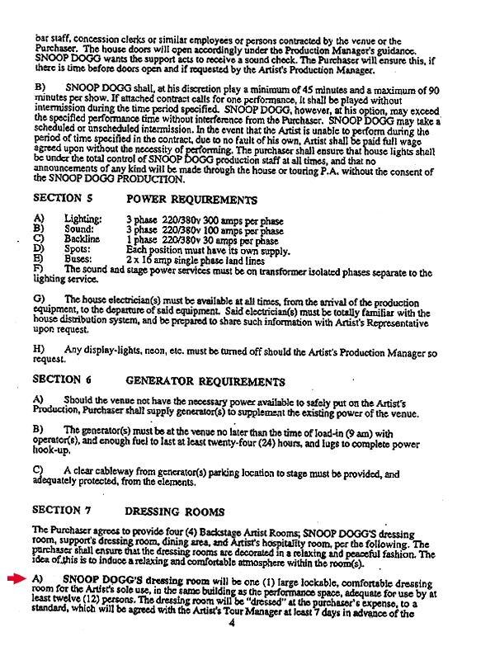
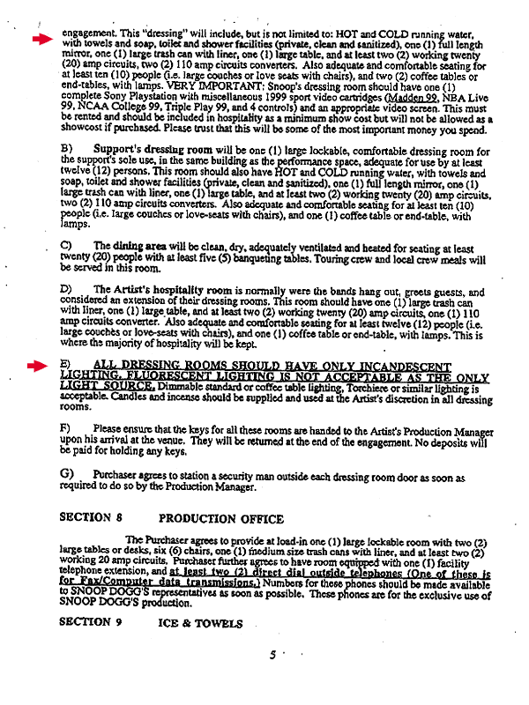

Slide 18
