Slide 1
Principles of Theater Practices
Module 8 – Properties applications

Slide 2
The different types of props
Hand props
Costume props
Personal props
Set props
Consumable props
Weaponry

Slide 3
Hand props
Items that the actor carries on with them or picks up from the set
Hand mirrors
Cups and bottles
Pencils and pens
Hand props should reasonably weigh what a genuine item would
This is for believability
A note on things that must break and be reassembled
Either have an exact copy of the breaking item to substitute back in
This is a consumable
Design the prop in such a way that the item can come apart believably then be reattached via magnets or pins or string

Slide 4
Costume props
Costume props are often accessories
Pocket watches
Holsters
Crowns
Glasses
Jewelry

Slide 5
Personal props
This is an item that is carried on the actor at all times
This could be a letter that is kept in a coat pocket
A jailer would have keys that may need to function attached to their belt

Slide 6
Set props
Set props are usually larger items that get moved or carried around
Pianos
Little women
Bleachers
Spelling bee
Punching bag
Death of a salesman
Piragua cart
In the heights
Different than set dressing
Appropriate additional items placed on set to complete a look
Not interacted with and not specifically referenced
Trim props
Curtains and blinds that are manipulated
Pictures that may be taken off the wall

Slide 7
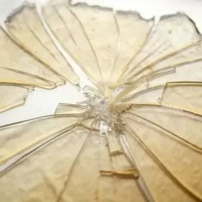
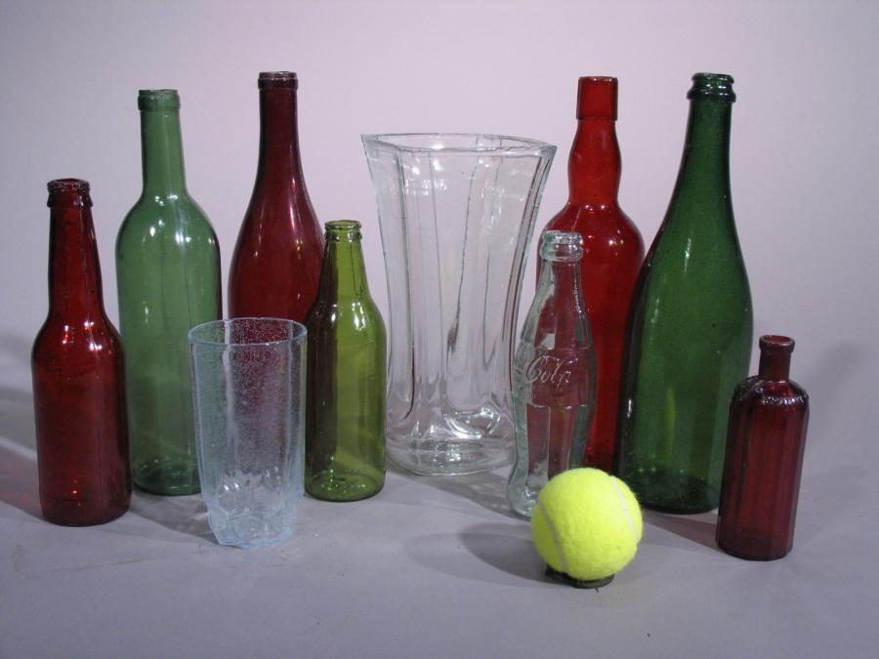
Consumable props
Consumable props are not just ones that are eaten. They are props that can be used for only a short time or only once
Food eaten on stage
Drink
Things that need to break
Sugar glass and commercial alternatives

Slide 8
A note on using real glass
Don’t!
Real glass will inevitably get broken
Hazardous to performers
Nearly impossible to thoroughly clean up
Poses a risk for the next production
Non-breakable alternatives exist and should be used with few exceptions

Slide 9
Weaponry
Swords, knives and guns
Armorer responsible for safe operation and maintenance
Fight choreographer can be tasked with making fights with weapons look believable but minimize potential for injury
Never use a “real” weapon on stage
Companies rent modified ”real weapons” altered for safety
Even plastic and wood can cause injury, understand clearly how item is being used

Slide 10
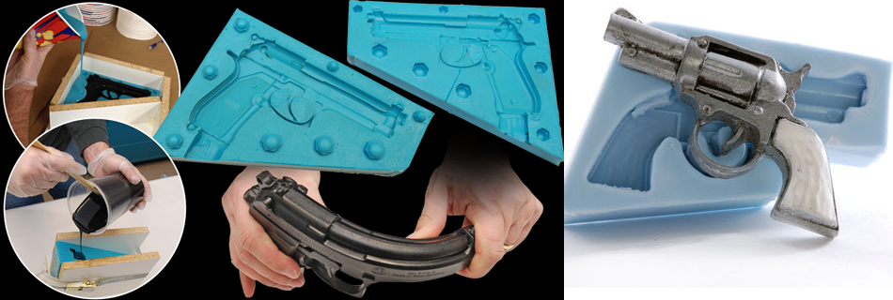
Practical and dummy props
Practical props are ones that behave as you would expect
Lanterns that the actor can turn on
Alarm clocks that can be snoozed when pressed
Cellphone lights
Dummy props are not capable of functioning, they merely look authentic. They are often made from a single material and made to look identical to a genuine item
Prop food
Rubber knives

Slide 11
Rehearsal props and show props
Rehearsal props are a stand in or place holder for the actors to use while in the rehearsal process
What would be a teacup for an actual show may be a plastic SOLO cup in rehearsal
Rehearsal props are inexpensive and should be either easily replaced or withstand any abuse an actor might inflict
Provided by the props dept as soon as possible in rehearsal process
Show props are the finalized item
They have been agreed upon by designer and director and are ready for actor use
They can be expensive and delicate although if being in the hands of actors, should be suitable for reasonable use and abuse
Provided by props dept by a props deadline so actors can get use to using the item(s) they’ll have for a show

Slide 12
Props designer
Responsible for generating a props list and knowing how the props are used in a show
Tracks props during rehearsals
Determines if more than one of the same prop is needed
Does research on period pieces
Budgets cost of props
Borrow, build, buy mentality
May be responsible for repairs of show props get damaged during run

Slide 13
Props runner/coordinator
Part of every tech/dress rehearsal and every show
Responsible for setting put props for the beginning of a show
Collects props at the end of a show and notes any damages
Reports damage to SM
May be responsible for making consumable props for day of show
Reports if consumable props are low
Installs batteries when necessary

Slide 14
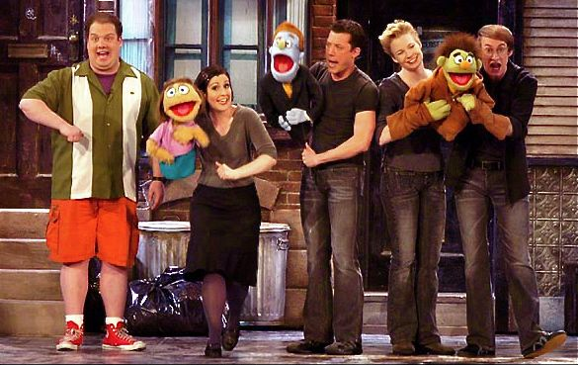
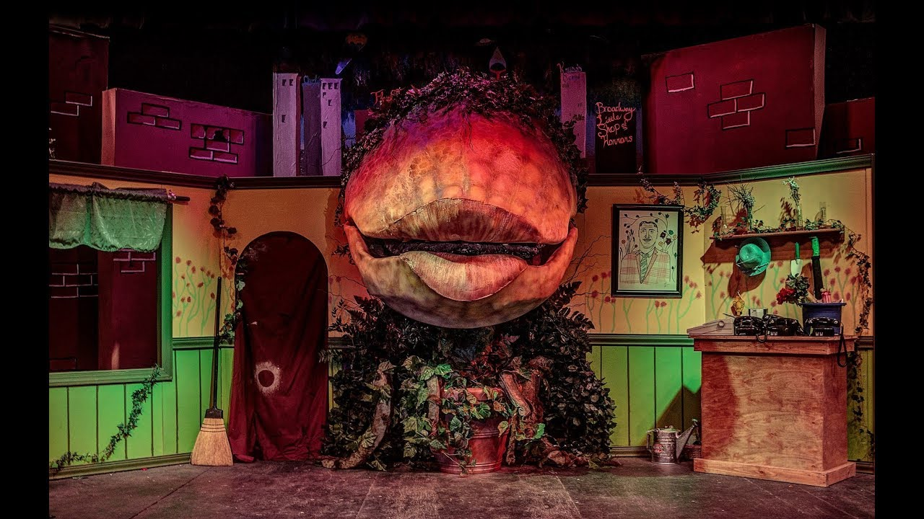
Puppetry
Hand prop
Set prop

