Slide 1
Principles of Theater Practices
Module 7 – Costume applications

Slide 2
When an actor walks onto stage for the first time, the audience’s feelings about the character will be based … on the information that guides all first impressions
J. M. Gillette

Slide 3
Costume Design
Anything worn on stage
Clothing
Undergarments
Footwear
Hairdressing
Makeup
Often masks (if not from props)

Slide 4
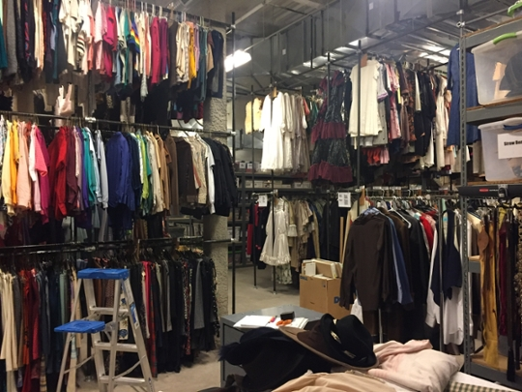
Acquiring costumes
As with many areas time and budget constraints require an evaluation on how to properly outfit a production
Renting
Buying
Borrowing
Pulling from own inventory
Modifying costumes to better suit the show
Building from scratch

Slide 5
The costume designer’s responsibility
A character’s costume influences an audience’s perception of that character. The costume designer’s responsibility is to develop a design that conveys an element of personal information for each character.
Even going so far as to restrict the way an actor moves, speaks, stands or sits on stage.
Need for rehearsal costumes

Slide 6
What do we get from costumes
Historical period
Age
Gender
Social status
Occupation
Climate/season

Slide 7
The designer’s process
Analysis of script
Any descriptions specifically mentioned
Period
Color
Shape
Research
Creative development
Conceptual choice
Implementation
Evaluation
Things to keep in mind
Budget
Director’s concept
Is it period and how loyal to period will you be
Timeline/deadlines (first dress rehearsal)
Scenic design color pallet
Don’t want costumes to blend in unintentionally
Lighting design color pallet
Lighting can completely alter the color of a costume

Slide 8
Red-Black vs. Blue-Black
Unless all garments are dyed together, different clothing manufactures and materials suppliers may use different black dyes.
This can create the appearance of mis-match or clashing black colors in costumes
Primarily due to the color of lights
Ex. Pants can appear black and a shirt could appear dark reddish-brown

Slide 9
Communicating concept
Costume sketches
Establish shape and form
Make quickly
Useful for talking points
Equivalent to a white card model for scenic
Costume renderings with swatches
Fully developed
Shows color and texture
May also show accessories
Informative for lights and scenic

Slide 10
Costume sketch vs. rendering

Slide 11
What is a costume parade
This is an established time where the majority, of not all costumes are available to be arranged in scenes on stage under likely lighting scenarios.
The goal is to see that all costume choices “fit with one another” and that there are no conflicts with lighting or scenery

Slide 12
Purpose of dress rehearsals
Usually get 2-3 in collegiate theater
Used to make sure actors can move and navigate set/blocking effectively
Determines if quick changes are needed and how many dressers are to be on hand
Troubleshoots layered costumes and special effects/trick costumes

Slide 13
Costume plot
A document that outlines what character is wearing what at that time in a performance
Useful for understanding how many changes a character will have
Helps make an inventory of items for each character in dressing room

Slide 14
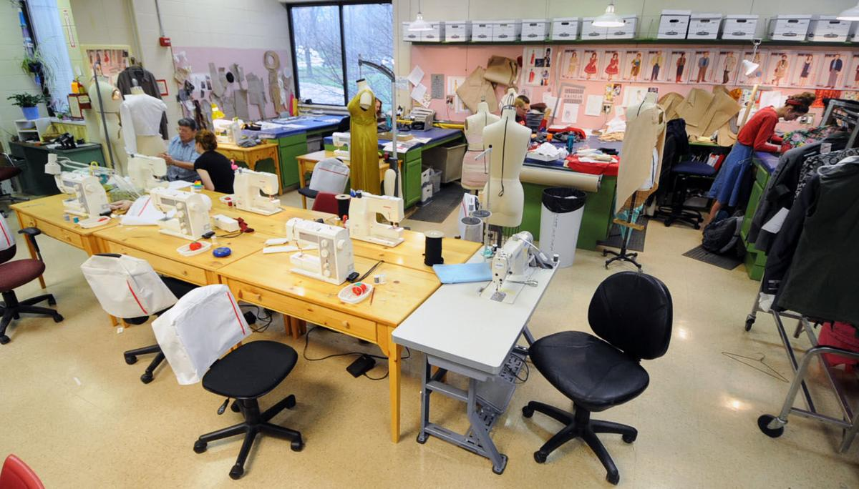
The costume shop
A location where costumes can be constructed and altered
Stores supplies and tools necessary for the craft
Managed by a scene shop supervisor
Has shop workers working under them
Typically, a large space with tables for cutting fabric and sewing machines around the perimeter

Slide 15
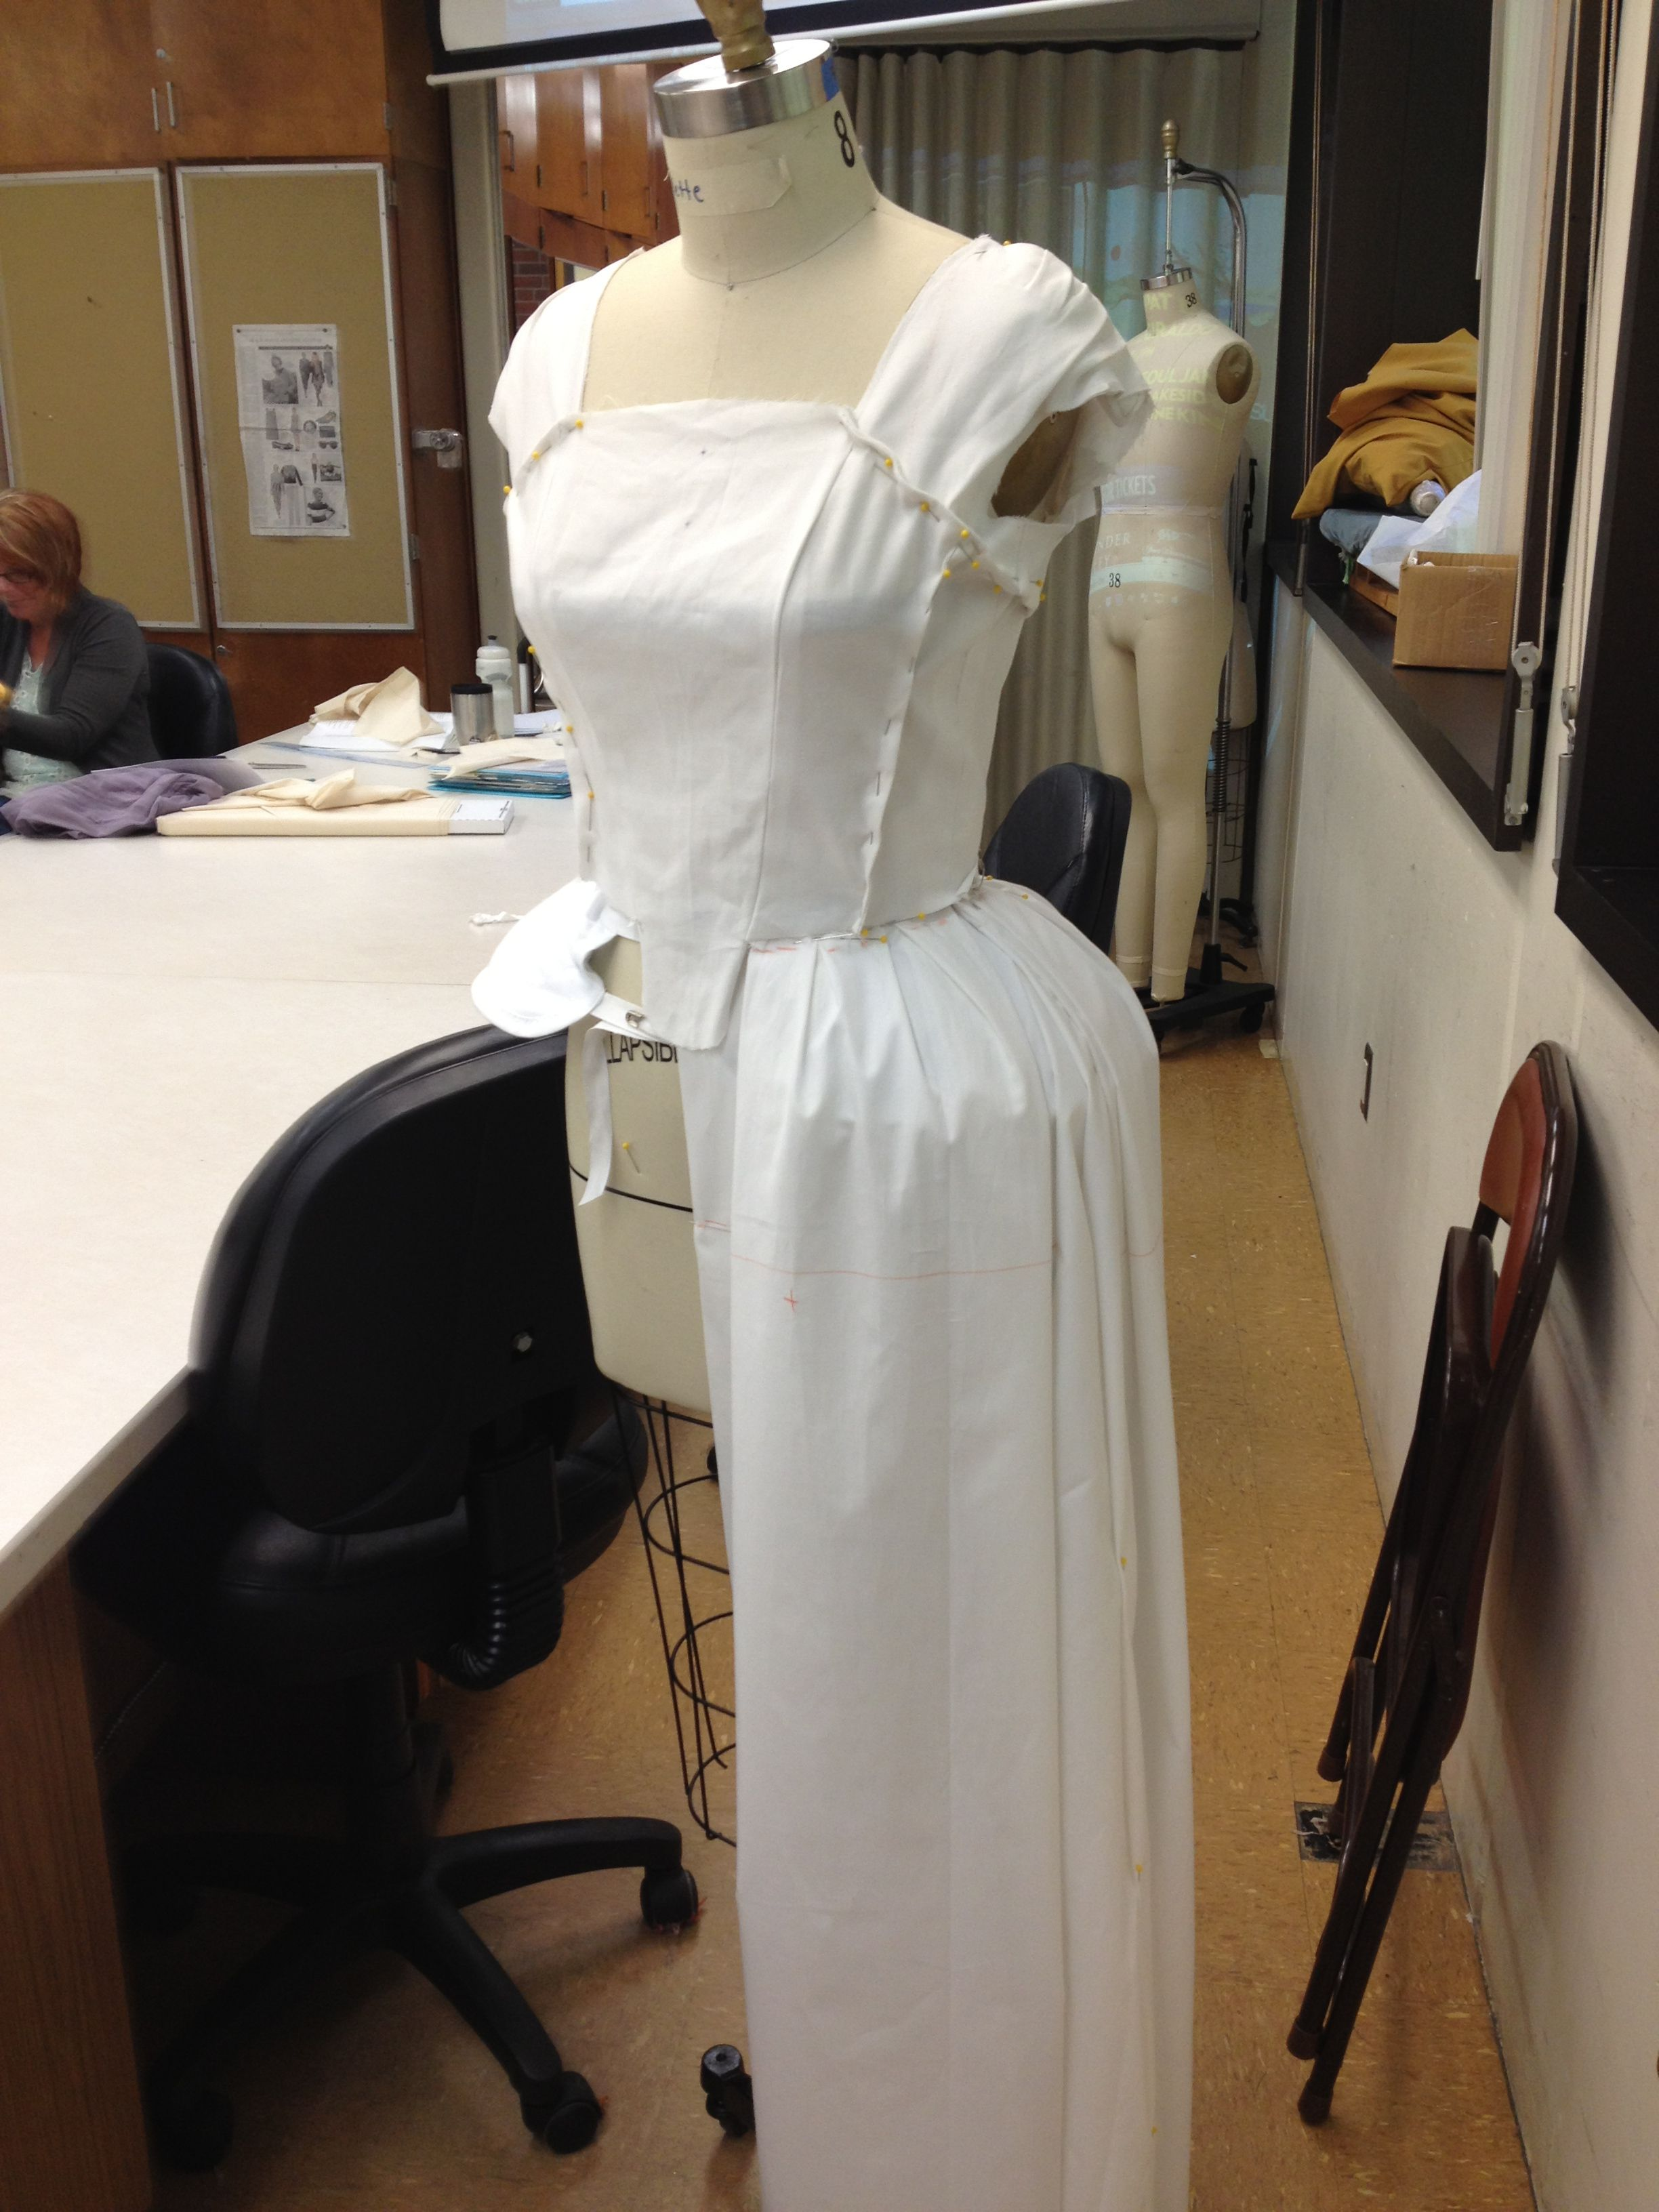
Costume construction
Patterns can be purchased
Paper drawings of each piece of the fabric needed to sew a garment
Once pattern fits most
Pieces cut appropriately for size of actor out of intended material
Draping
Using an appropriately sized form to layer and drape fabric for desired look
Often developed in muslin first

Slide 16
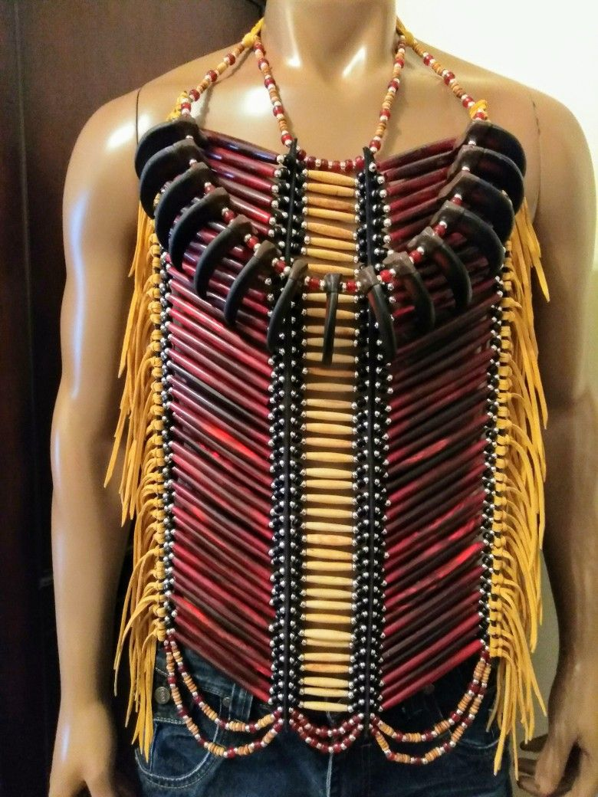
Beading
Done by hand
Takes time but nothing compares to level of detail
Often requires the garment to be hand washed
Beads can be glass, plastic or wood

Slide 17
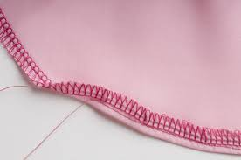
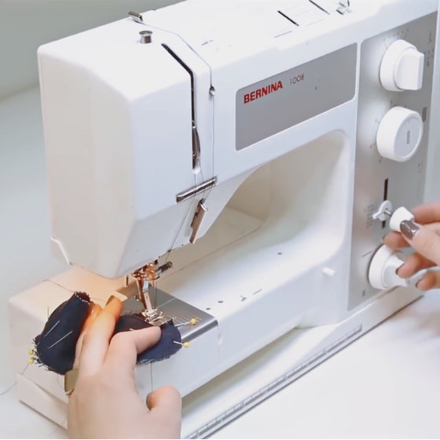
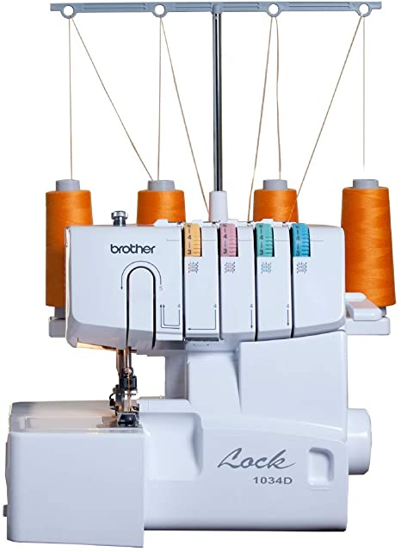
Tools of the trade
Sewing machine
Serger

Slide 18
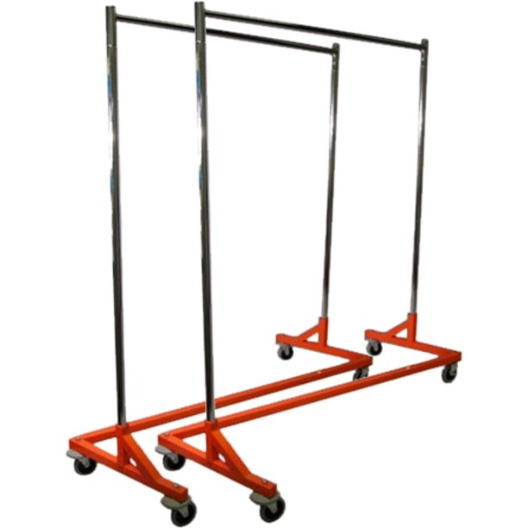
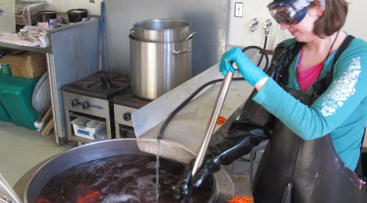
Tools of the trade cont.
Z-bar (rolling costume rack)
Dress form
Steamer
Dye vat
Iron/ironing board
Washing machine
Drier

Slide 19
Costume craft
Additional costume-related items often come up in shows. There is a specific area of costuming that differentiates itself. Almost a costume/props hybrid
This role require prototyping and making mockups of items often never created before

