Slide 1
Principles of Theater Practices
Module 6 – Light applications

Slide 2
Its not a light bulb – it’s a lamp!
Lamp = the lighting element that emits the light
Fixture = the functional or decorative item that holds the lamp as well as provides the power. The fixture may also contain a switch
Another name for a fixture is a Luminaire

Slide 3
A practical light or fixture
A scenic element that functions to some degree as a light source

Slide 4
Conventional vs LED

Slide 5
Conventional fixtures
Par cans
Fresnel
Ellipsoidal reflector spotlight (ERS)

Slide 6
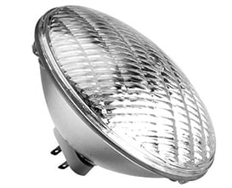
Par cans
Simplest design
Came in 3 sizes
Par 38, 56, 64
One focus adjustment
Vertical or horizontal oval
Beam width adjustments required swapping out lamps
Can be colored using gel
Gets HOT!

Slide 7
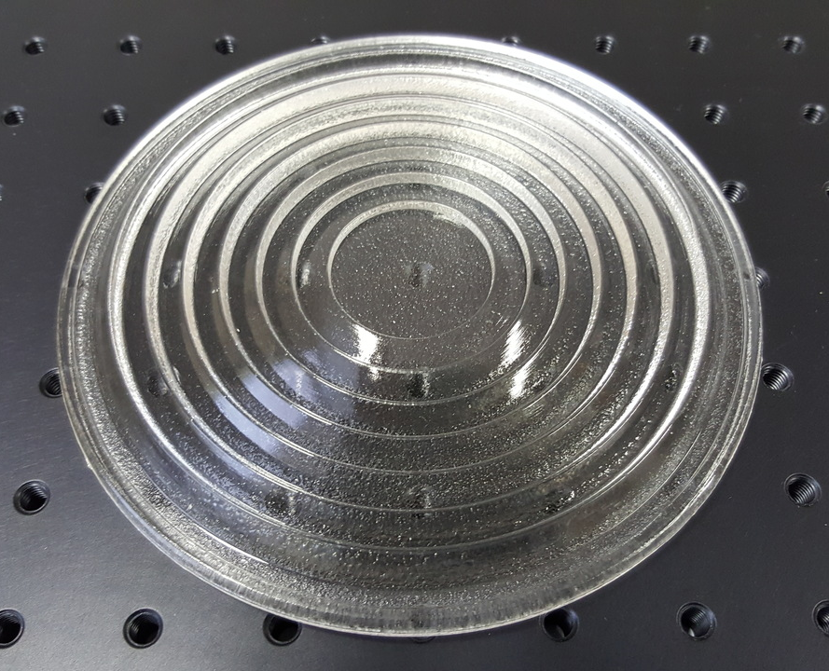
Fresnel
Unique lens design
One focus adjustment
Adjustable size circle of light
Can be colored using gel
Gets HOT!

Slide 8
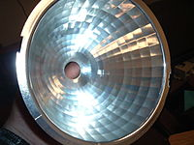
Ellipsoidal reflector spotlight (ERS)
Many adjustments
Focus
Shutter
Hotspot
Barrel rotation
Size of beam can be changed by swapping lenses
Can be colored using gel
Can have a pattern (GOBO) installed
Gets HOT!

Slide 9
Shape of reflector and adjustable lenses is how you can get pattern

Slide 10
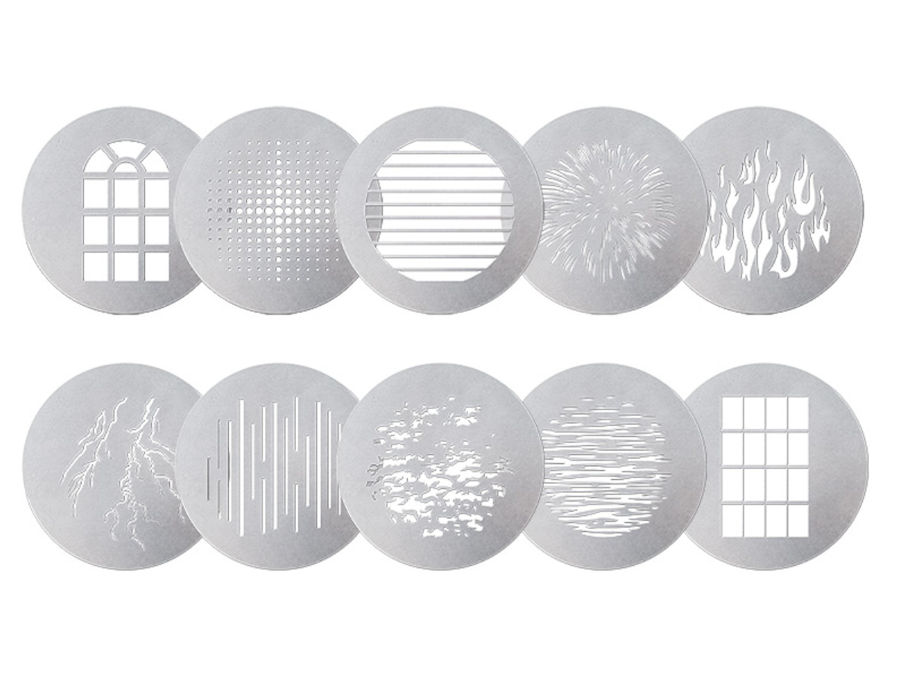
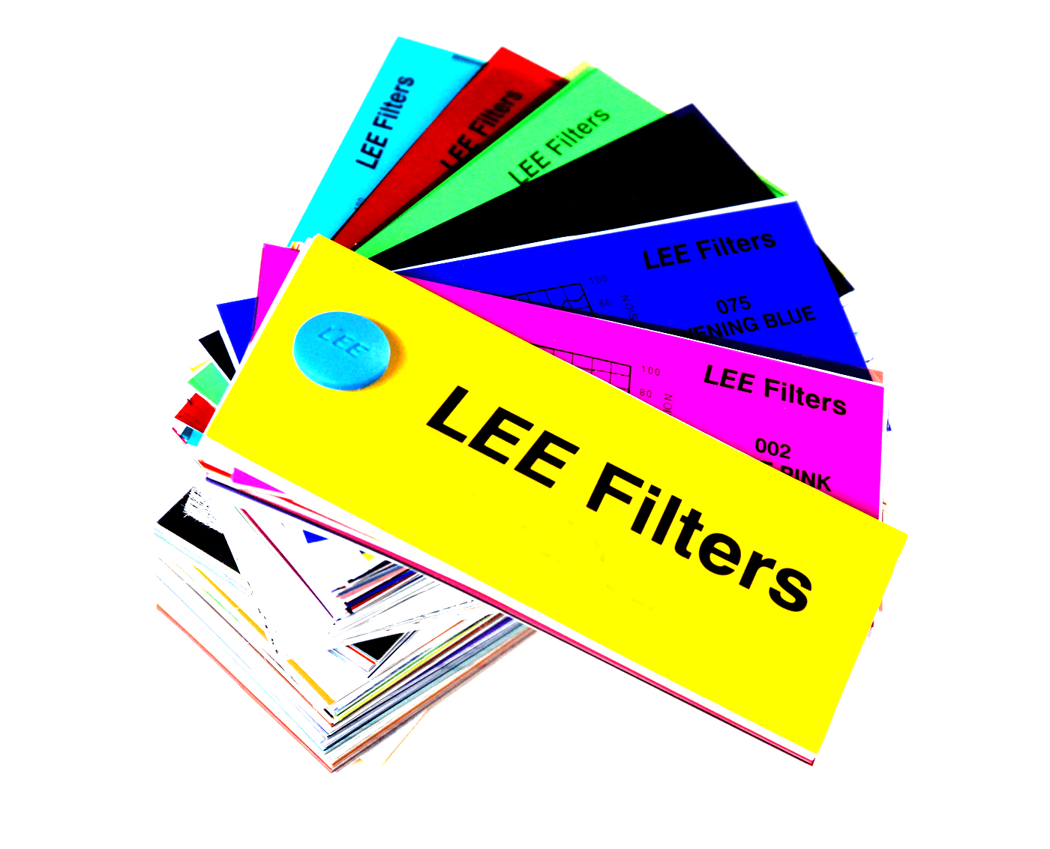
Gel and GOBOS
Gel is colored media
Originally was made form gelatin
Now made of plastic or glass
Also called a color filter
GOBO = Go Between
Also called pattern or a template
Can be made of steel or glass

Slide 11
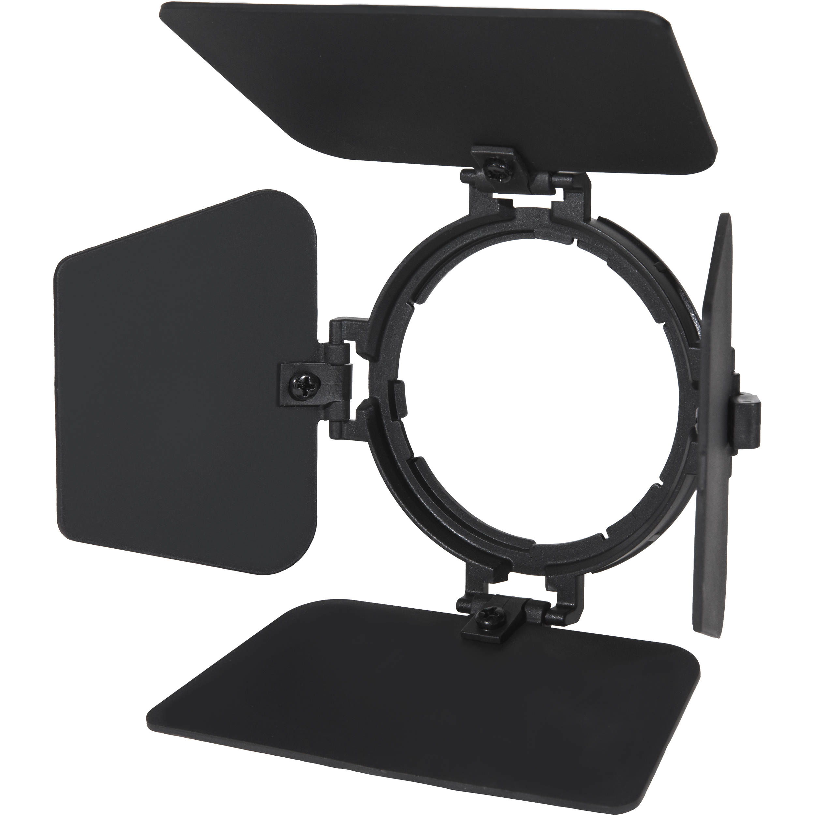
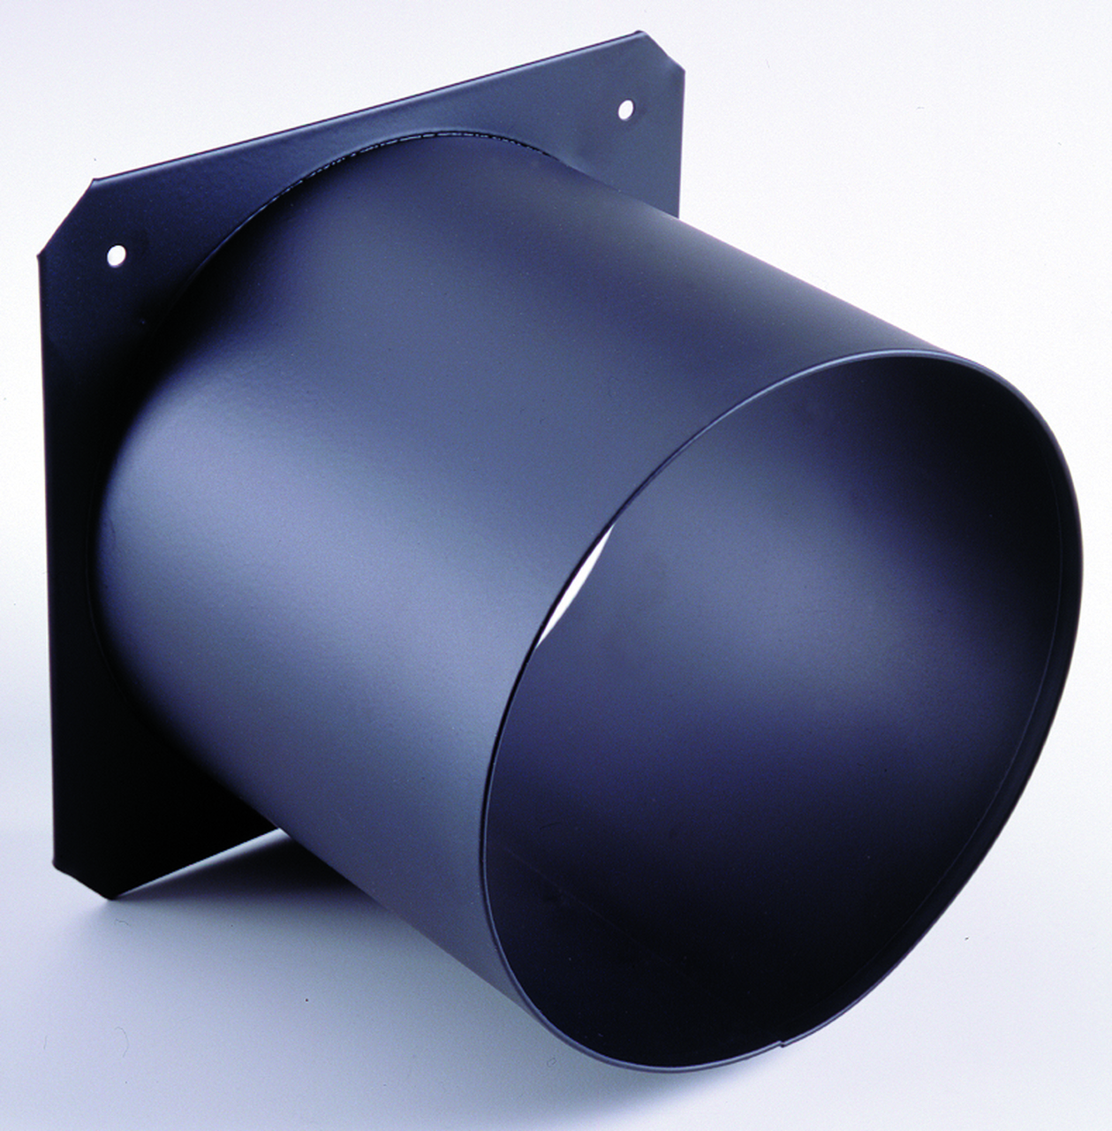
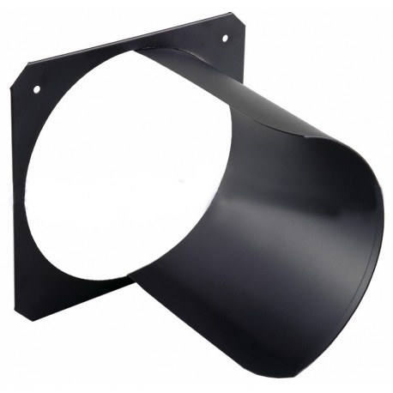
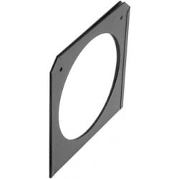
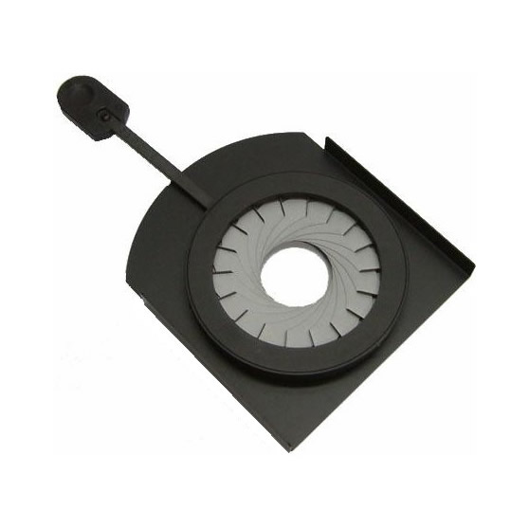
Accessories
Barn doors
Top hat/half hat
Gel frame
Iris
GOBO rotator
GOBO scroller

Slide 12
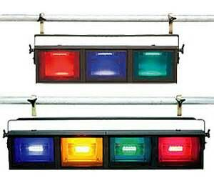
Cyc lights
Either individual cells or bands of 3-4
High light output
Gets VERY hot

Slide 13
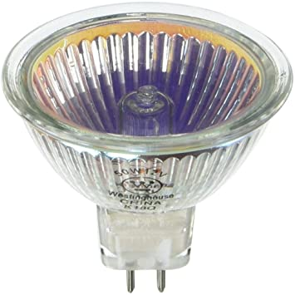
Strip lights
Many circuits so chase effects can happen
Smaller form factor
Good for up lighting
Good for lighting backdrops/cycs
Can be colored using gel
Gets HOT!

Slide 14
Foot lights
Fixtures downstage that provide a front/up light
Does help illuminate under hats and over head props (umbrellas)
Used for a vaudeville aesthetic

Slide 15
Follow spotlight
Used to track actors/performers around the stage
Requires an operator
Has the ability to adjust color/focus/iris

Slide 16
Controlling conventional fixtures
Lightboard sends commands
Commands sent over cable to dimmer room
Each dimmer has an address
When address is called a percentage 0-100 is sent to dimmer
Electricity from dimmer sent to light fixture
Lamp in fixtures glows at the percentage requested

Slide 17
Defining terms
Light board
Console that lighting commands come from – programable
Address
The unique number/location of a dimmer
Dimmer
Conventional electrical device that can vary amounts of electricity
Circuit
The network of wires, dimmer and plug unique to one address

Slide 18
Moving fixtures (movers)
Can move on command without manual interaction
Often have build in color wheels (gel)
Often have a built-in set of GOBOs
Also gobo rotation
Often have built-in focus
Have a built-in douser
Possible mechanical strobe
Use a bright light source
Last up to ~2000hrs
Gets HOT!
Requires constant power source

Slide 19
Controlling intelligent fixtures
Pan left to right 0 - 270 degrees
Tilt front to back -90 - +90 degrees
Intensity 0 -100
Shift focus in – out
First color wheel 1-16
Second color wheel 1-16
Gobo selection 1-16
Gobo rotation
Facet (splits gobo into 3)
Facet rotation
Douser open – closed
Each feature needs an individual control, because of this intelligent fixtures require more than one address, in fact, an address is needed for each feature in use.
Some moving light can use 56 address

Slide 20
LED instruments
These are also called intelligent fixtures
The simplest of fixtures just turn on/off
Most have other capabilities
Communicates using same light board (DMX)
Most have built in dimmers
Most require constant power source

Slide 21
DMX (digital multiplex)
DMX is the communication protocol for modern lighting equipment
Uses a 3 or 5 pin connector or RJ45
Fixtures are daisy chained
Light boards talk to dimer racks as well as intelligent lights with these commands
Fixtures are assigned a starting address using DIP switches or a menu
An address can be in the range of 1 – 512
Address # of multi-address lights cannot overlap

Slide 22
LED par
Wide range of colors from one fixture
Lighter weight
Can strobe
Long life from LEDs
Only gets warm

Slide 23
LED LIKO equivalent
Wide range of colors from one fixture
Can use same lenses as conventional fixtures
Light weight
Can strobe
Long life from LEDs
Only gets warm

Slide 24
LED mover
Wide range of colors from one fixture
Lighter weight
Can strobe
Long life from LEDs
Only gets warm

Slide 25
LED strip lights
Color changing
Some are foxed position
Some can move
Can do effects
Strobe
Color chase

