Slide 1
Principles of Theater Practices
Module 5 – Sound applications

Slide 2
Signal path
Source
Generates the signals
Manipulator
Modifies the signal(s)
Amplifier
Makes the signal(s) more powerful
Reproducer
Makes the signal(s) audible

Slide 3
What is a source
What are some devices that generate signals?

Slide 4
Examples of sources
Microphone
Electric guitar
CD player
iPod
Digital piano*
Computer sound card
RF tuner
Record player
Cassette player
Reel to reel player
8-track player

Slide 5
What is a manipulator
What are some devices that alter audio signals?

Slide 6
Examples of manipulators
Sound mixer (soundboard)
Equalizer
Reverb device
Effects processor

Slide 7
What is an amplifier
What are some device….
An example of an amplifier is an AMPLIFIER!
Sole purpose to take low level signals in and export high levels

Slide 8
What is a reproducer
Speakers
Bass shakers
Off-centered motor

Slide 9
Wait, speakers can be motors – Huh?
Mechanical woofers
Rotary woofers
Silly sound folks coming up with crazy ideas

Slide 10
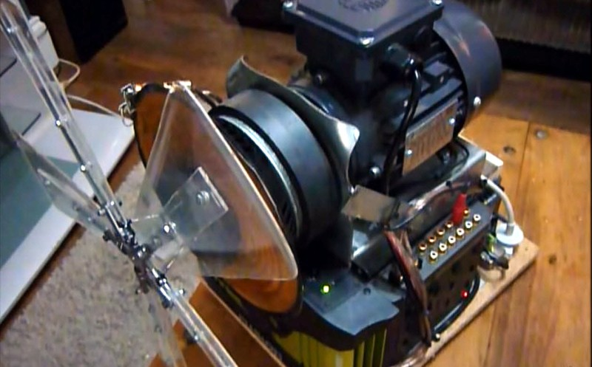
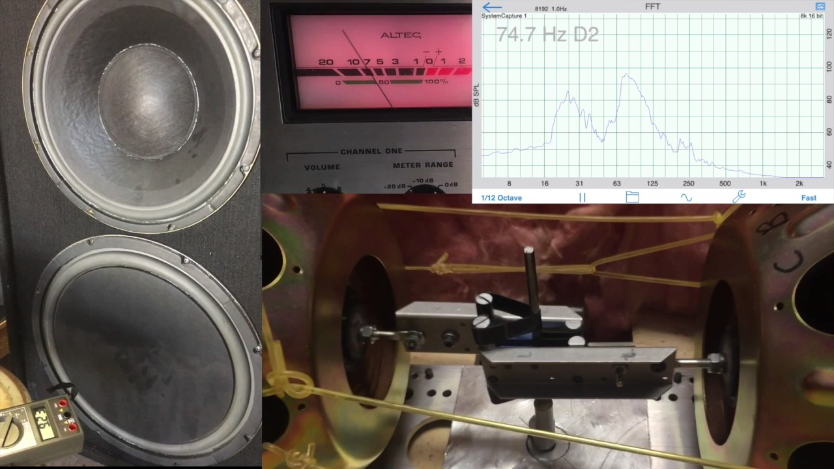

Slide 11
Concept - surround sound vs. directional sound
Surround sound – aimed to give all listeners the same sound experience
This is how movies and multi-channel audio recordings are intended to ne heard
Example – the helicopter circling around the room
Directional sound – designed to convince an audience that sound is coming from a particular direction not necessarily expecting that each listener hear the exact same way

Slide 12
Multi-channel audio
Stereo – 2ch. Left and Right
2.1 – 3ch. Left, Right and Low Frequency Channel LFC*
Quadraphonic - 4ch. Front Left + Right and Rear Left + Right
3.1 – 4ch. Front Left + Center + Right + LFC
4.1 – 5ch. Front Left + Right, Rear Left + Right and LFC
5.1 – 6ch. Front Left + Center + Right, Rear Left + Right and LFC
7.1– 8ch. Front L,C,R, Rear L and R, LFC, Sides L and R
9.1 – 10ch. Front L,C,R, Front High L and R, Rear L and R, LFC, Sides L and R
Other possible channels could be VOG, rear center, additional LFC’s
*LFC is often referred to as Subwoofer channel

Slide 13
Sound designer position
Part of the creative team
Responsible for crafting the soundscapes and sound effects
May also be a music composer
Attends design meeting and production meetings
Fluent with software cueing software
Qlab or SFX

Slide 14
Sound engineer (A1)
Responsible for bringing the sound designer’s creativity to life
Likely will be in charge of the load-in of sound equipment for the front of house
Regularly is the live mixer for productions
Often is positioned in the middle of the audience to appropriately hear
Fluent with the menus and operations of the soundboard used

Slide 15
Audio assistant (A2)
Often located backstage
Sets up the backstage monitors and communication systems
Responsible for the load-in of onstage/backstage audio equipment
Microphone wrangler
Microphone troubleshooter
May operate a smaller soundboard for monitor mixes for performers

Slide 16
Backline
A term used for assistants to the production.
A term that relates to the musician's gear onstage
Responsibilities
Help take down microphone equipment
Help box up drum sets
Help store keyboards
May be responsible for moving guitar amplifiers

