Slide 1
Principles of Theater Practices
Module 4 – A/V & Multimedia applications

Slide 2
Defining terms
A/V
Literally stand for Audio/Video
Multimedia
Using more than one form of media for artistic expression

Slide 3
Looking at the equipment
Audio
Cylinders
Records (Vinyl)
Wire recorders
Reel to reel
Tapes
CD & mini-disks
Video
Slide projectors
Film
Capacitance Electronic Disc (CED)
VHS & Betabax
Laserdisc
VCD & DVD

Slide 4
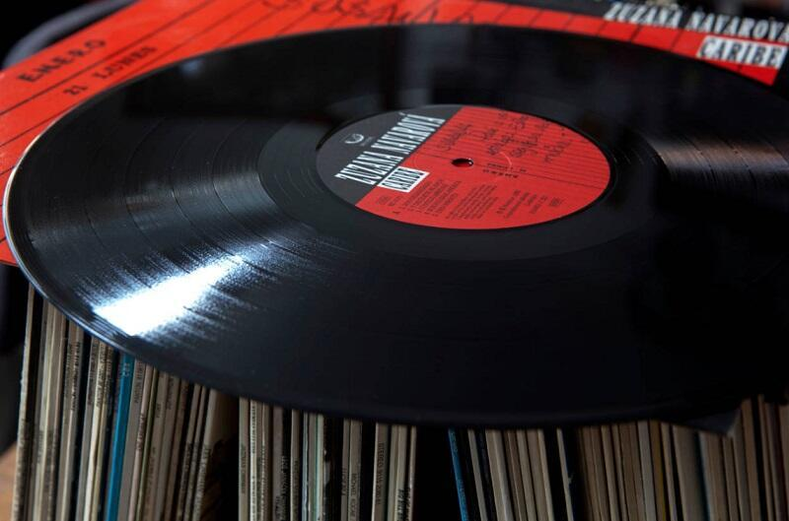
Cylinders and Records - Audio
First recordings captured to media
Made of hard wax, shellack, or later Vinyl (1943)
Spall grooves are “cut” into surface
Mass-produced vinyl was pressed
A stylus rides in the grooves to reproduce sound
Records could be 2-sided
Later record players were electrified (1888)

Slide 5
Close up of record

Slide 6
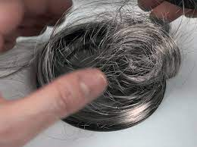
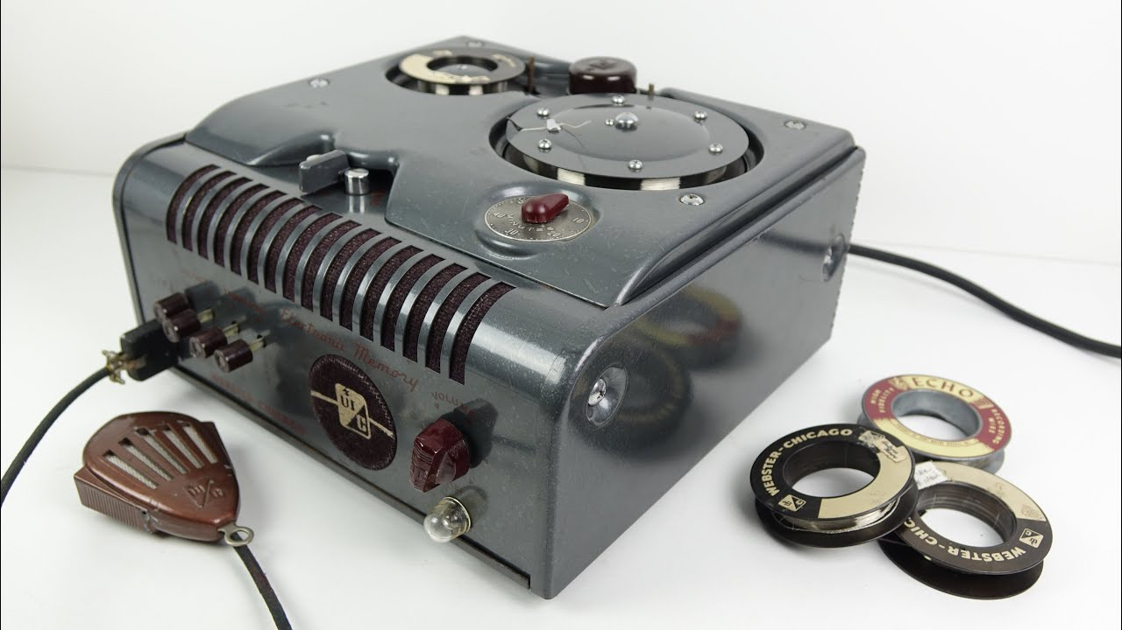
Wire recorder - Audio
Used a spool of stainless-steel wire that has been magnetically manipulated
Featured in Death of a Salesman
Wire about as thick as human hair
Wire passed across a magnetic head that reads the magnetic information
Wire is respooled on an additional spool once read
Marketed in 1914

Slide 7
Reel to reel - Audio
Used a reel of magnetic tape
Has forward and reverse
Multiple tracks can be recorded at tame time
Editing can be a challenge
Different than re-recording
Had the ability to record cue information
Standard for a long time in theater

Slide 8
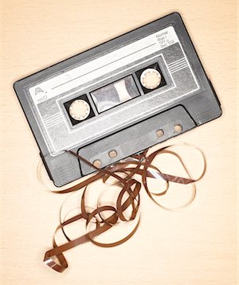
Tape - Audio
Introduced in 1963
Also uses magnetic head to read information from tape
Widely popular/portable
8-track
Compact cassette
Transitioned from 8-track to modern cassette in 1982
Cassette bi-directional

Slide 9
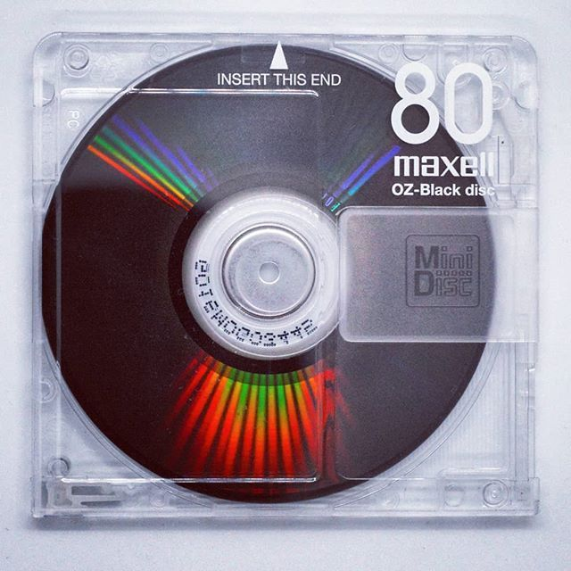
CD & Mini-disc - Audio
Made of plastic and reflective foil
Records digitally
Error correction
Does not degrade from use*
CD’s surface exposed, Mini-disc enclosed in a protective case

Slide 10
Slide projector - Video
Slides are made from camera film
Developed like pictures but the positive image, not negative
Mounted on mattes for structure and handling
Uses a bright light to transmit image to surface
Loaded in order into a cassette
Some cassettes can hold up for 400 slides
Slides are advanced by manually pushing a button or the machine receiving a cue triggered by audio

Slide 11
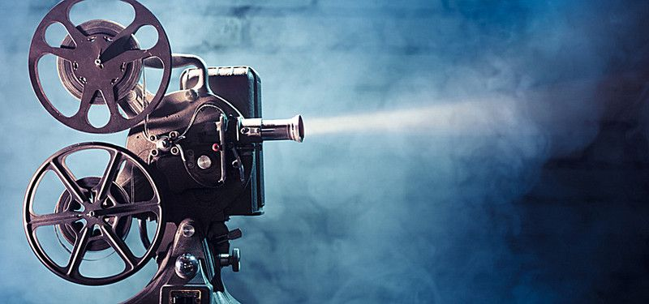
Film - Video
Film is captured via a camera
Edited by cutting between individual frames
Also transmitted by bright light source
Quality of image dependent on size of film

Slide 12
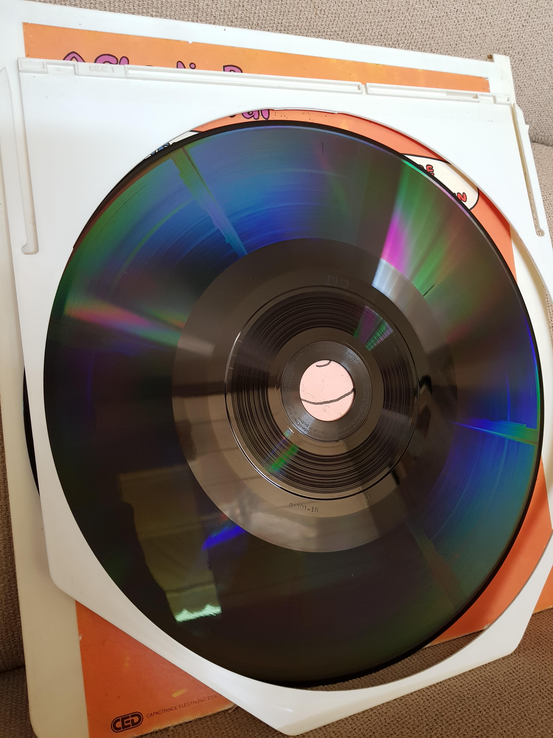
Capacitance Electronic Disk system - Video
Early form of video and audio combined
Video recorded in same method as record
Limited to 60 minutes per disk

Slide 13
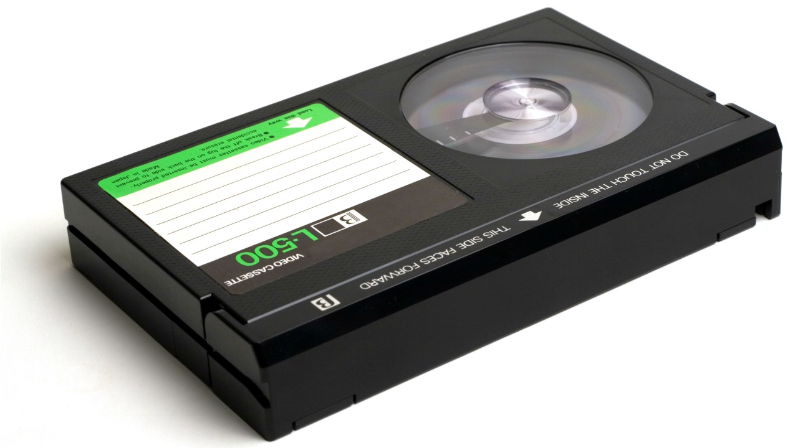
VHS and Betamax- Video
Magnetic tape that contains video and audio information
Contained in a plastic housing

Slide 14
Laserdisc - Video
Made of plastic and reflective foil
Digital information
2 sided
Audio is included on disk
Precursor to the DVD

Slide 15
VCD, DVD, and Blu-ray - Video
Also made of plastic and reflective foil
Also digital information
Audio included on disc
Smaller physical size than Laserdisc
Can be double sided
Also double density
Laser technology allowed for advancement in storage size

Slide 16
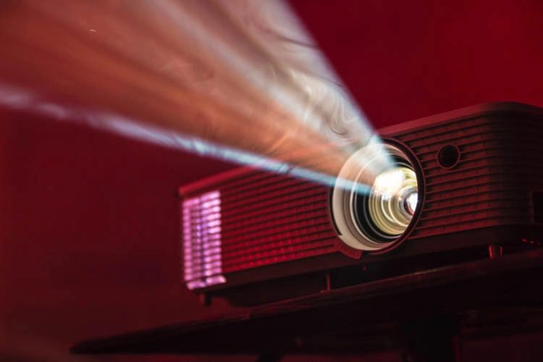
LCD projectors - Video
Dependent on a computer
Single and 3 LCD varieties
Digital black and dousers
Improvements over time
Resolution and brightness
Additional brightness by stacking
Polarizing for 3D effects
Eventual adaption of an LED lamp
Lamp life

Slide 17
Laser projectors - Video
The next advancement from lamps
Superior brightness and lamp life
10 years or more
Uses R, G, & B lasers to generate an ultra bright light source that creates far less heat than a conventional light source
Lower heat allows for more mounting options

Slide 18
Video cables/connectors
RCA
Coax
BNC
S-Video
Composite (RCA or BNC)
VGA
DVI
HDMI
DisplayPort (DP)
SDI
Ethernet cable

Slide 19
RCA connector
Analog video
Likely last used on mid 2000’s DVD players
As length increases color information decreases

Slide 20
Coax cable
Can carry both analog and digital signal
Used heavily in early television transmssion

Slide 21
BNC cable
Uses same cable as coax
Often found on video cameras and CCTV (video monitor)

Slide 22
S-Video
Offered higher resolution analog connection
Many TV’s still have this connection

Slide 23
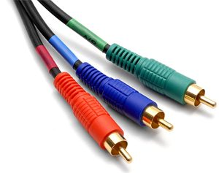
Composite cable
Uses RCA or BNC connectors
Separates the analog Red, Green and Blue video information on independent wires
Found on TV’s, monitors, and higher end video recorders

Slide 24
VGA
Analog video signal
The standard for monitors and projectors for many years

Slide 25
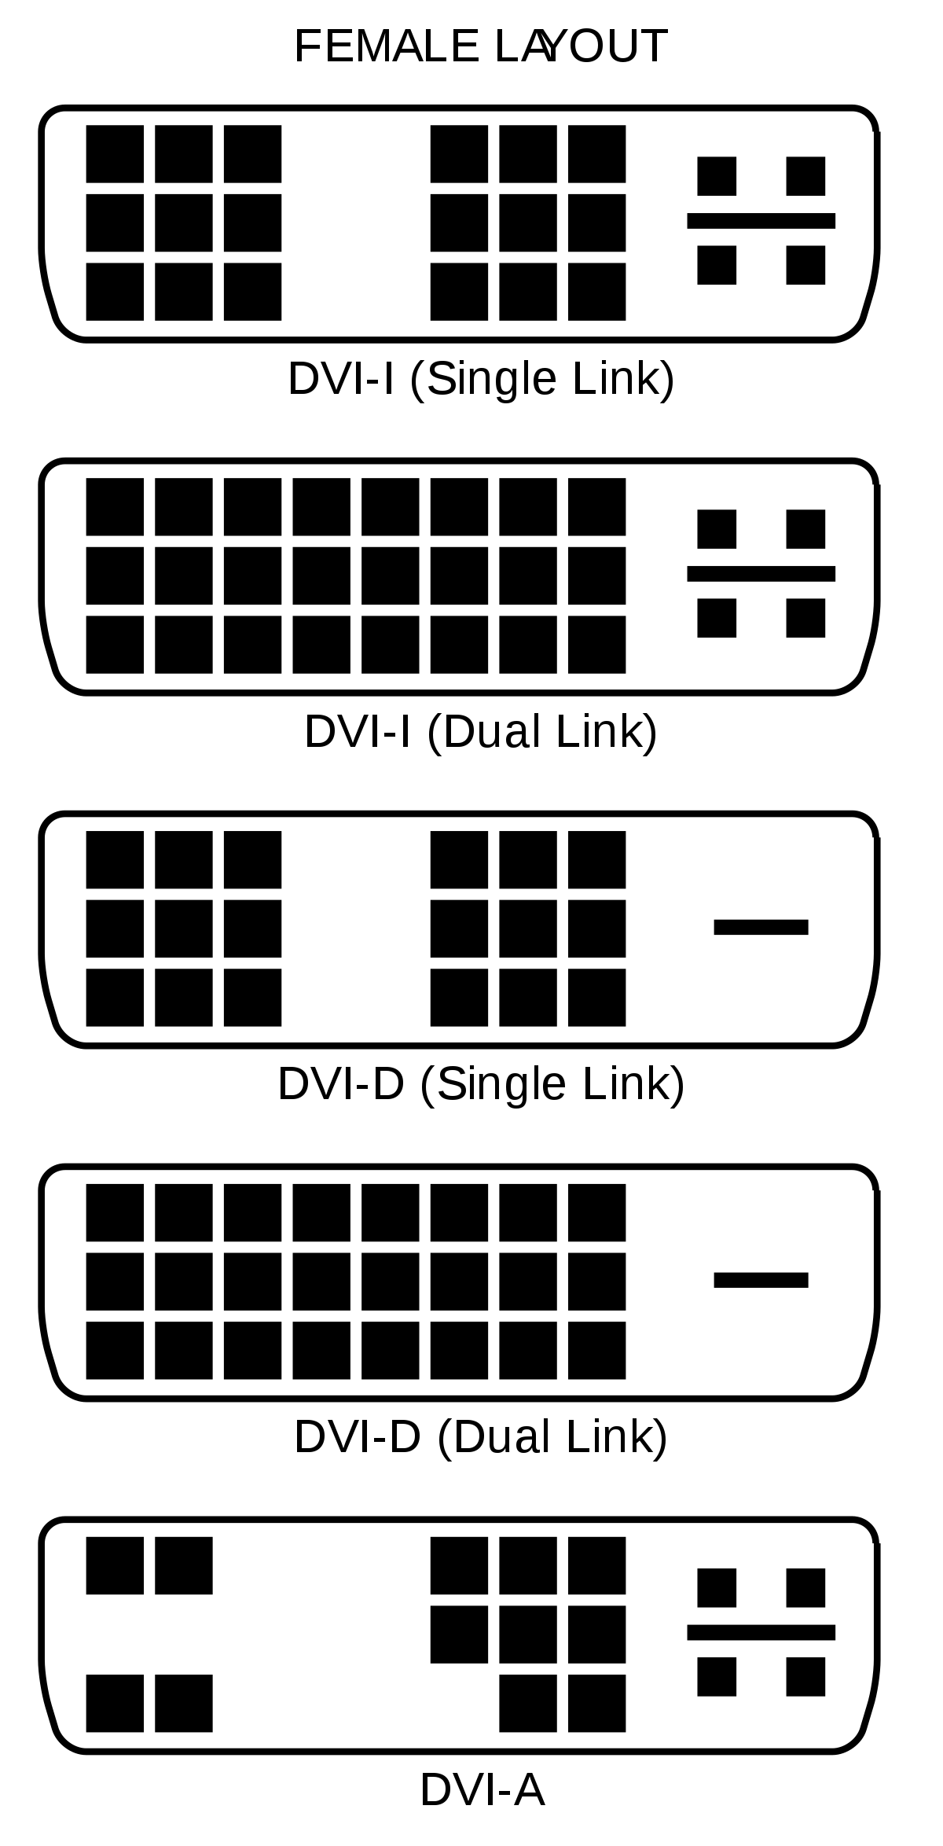
DVI
Digital signals
Higher resolution and sharper image
Found on higher end computer graphics and projectors

Slide 26
HDMI
Standard video connection today
Can carry audio and ethernet as well as video signal
Supports Resolutions up to 4K

Slide 27
SDI
Digital Signal
Supports resolution beyond 4K
Can run about 300 feet before signal degradation
Found on modern broadcast equipment and projectors

Slide 28
Ethernet cable
Digital information
Found on high end video players, TVs and Projectors

Slide 29
Ethernet cable (RJ45 connector)
CAT Type | Distance in meters | Distance in feet
CAT5e/6 @ 4K | up to 35 meters | up to 115 feet
CAT5e/6 @ 1080p | up to 60 meters | up to 200 feet
CAT6a/7 @ 4K | up to 40 meters | up to 130 feet
CAT6a/7 @ 1080p | up to 70 meters | up to 230 feet

Slide 30
Projection surfaces
Painted surfaces
Unless white distorts projection color
Shiny surfaces show hotspot
Front projection screens
Work well unless standing in front
Not great with haze
Rear projection screens
Lesser quality screens have hotspot

Slide 31
Projecting on irregular surfaces
Surfaces distort projection unless you can counter distortion
Some projectors have curved wall correction (prevents hourglass image)
Software can intentionally counter-distort offering many possibilities
Called projection mapping
Gives the illusion of multiple projectors
QLab and Isadora can do this

Slide 32
Pepper’s ghost
Creates a hologram like effect

Slide 33
Video wall
Comes in solid and curtain form
Curtain can be translucent
Solid walls are made of LED panels
Size of wall is scalable and reconfigurable
Solid walls can be floor standing or suspended in the air
Panels can be built into scenery
Can be manufactured to be waterproof
Brightness of wall can overpower stage lights

Slide 34
The computer
Source for media as well as player
With SSD technology, no moving parts
Storage size has increased without increasing physical space
Reliable and programable
Still have need for redundant systems

