Slide 1
Principles of Theater Practices
Module 2 – Scene shift Techniques

Slide 2
For all the shows that have multiple locations, we have scene changes
Let’s shine a light on what happens behind the curtain

Slide 3
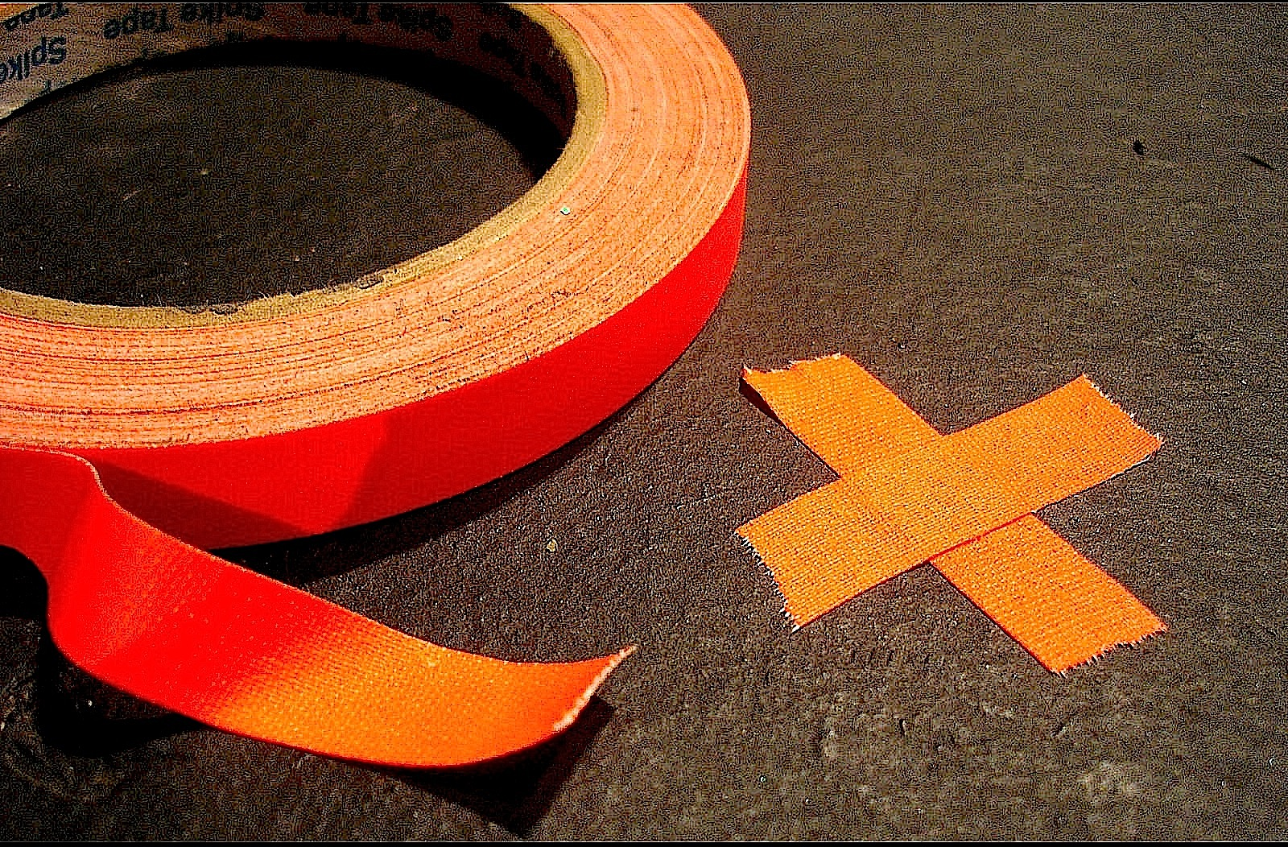
What is spike tape, and what’s it for
A type of fabric tape
  Can be torn by hand
Most popular in ½” width
Has a unique adhesive that doesn’t leave a residue
Comes in a variety of colors
  Some UV responsive
Used to denote placement on stage
  For furniture and actors too
One show can use multiple colors

Slide 4
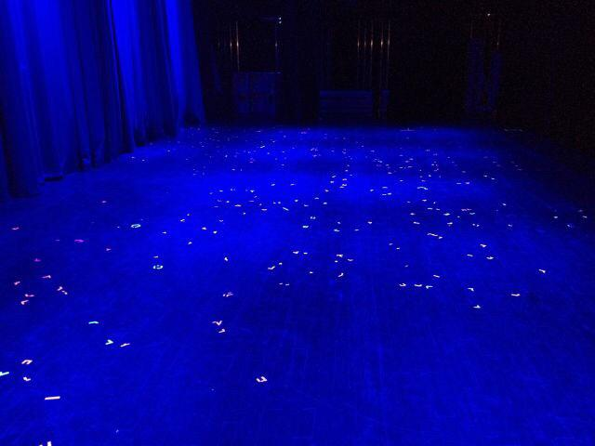

Slide 5
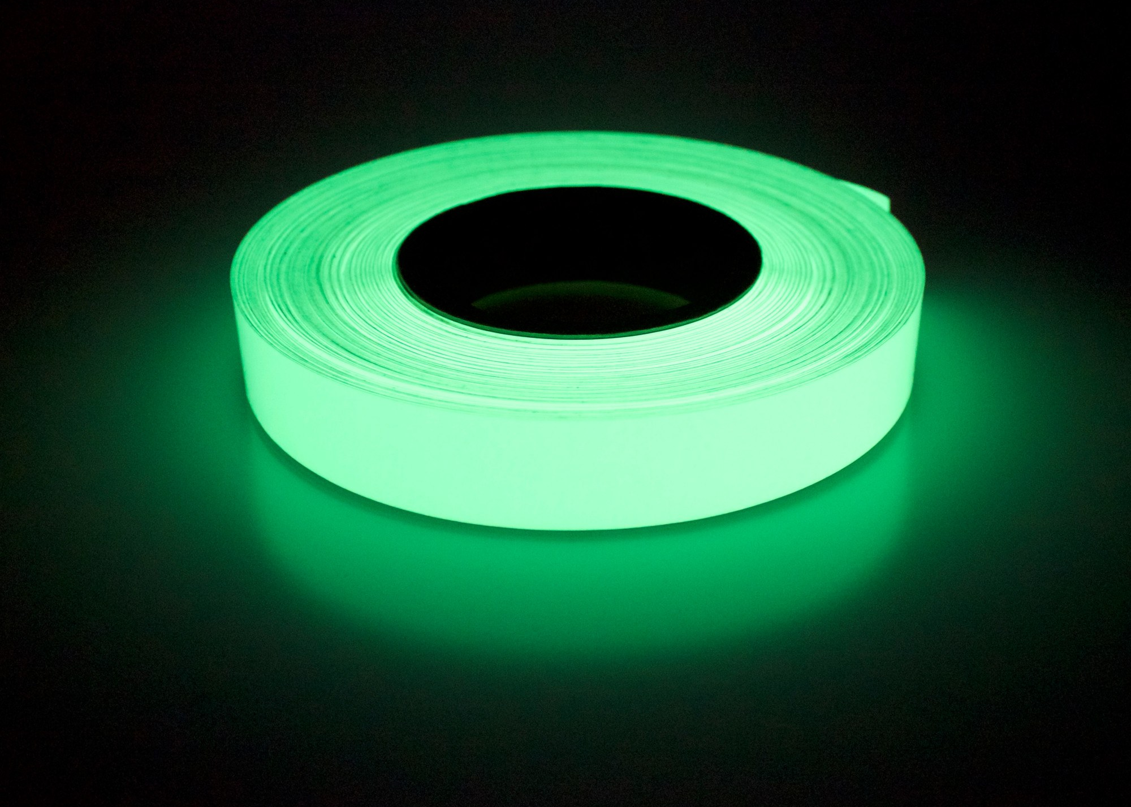
What if changes happen in a blackout?
We use glow tape when visibility is low
Glow tape is also used to identify the edges of platforms and stairs
Used wherever something of interest needs to be seen in the dark
Needs to be charged
Has to be cut scissors/knife

Slide 6
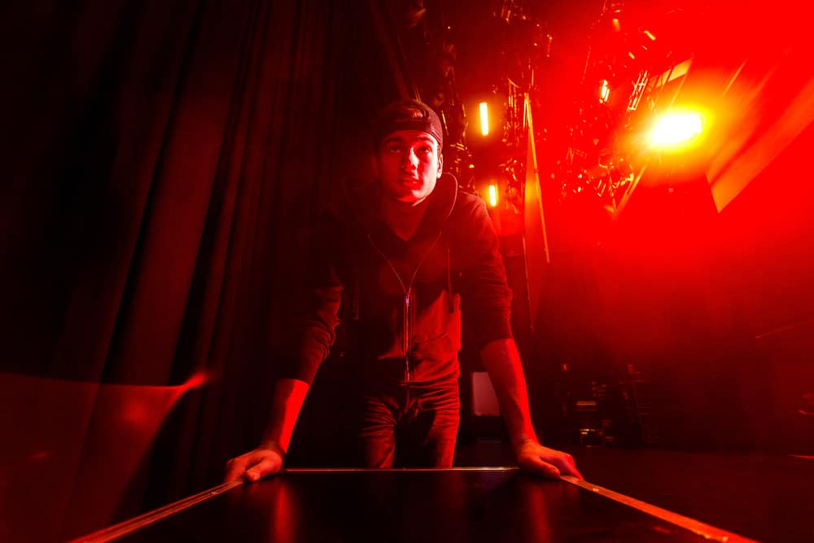
Who orchestrates a scene shift?
Scene shifts initiated by SM over headset
Deck chief (on headset) gives commands to deck crew
  Mostly hand signals or cue lights
Once shift is complete deck chief reports back to SM that stage is ready

Slide 7
A likely scene change scenario
Actors finish delivering their lines in ta scene
Stage lights fade to black (black out)
Actors walk off stage
Stage illuminates subtly in dark blue light (blue out)
Stagehands take off/on furniture/set pieces and place on spikes
Stage lights fade to black
Actors enter the stage
Actors begin to deliver next scene’s lines

Slide 8
Some productions have an automation department
Automation if the use of mechanical equipment to replace manual interaction
Automation can employ the use of electrical(motors), pneumatics (air), and hydraulics (oil) to make objects move
Automation systems can be under the stage floor, within the stage, or over head

