Slide 1
Principles of Theater Practices
Module 2 – Organizational Structure

Slide 2
Putting on a theater production takes so many people not including the actors
Lets look at the hierarchy of a production team

Slide 3
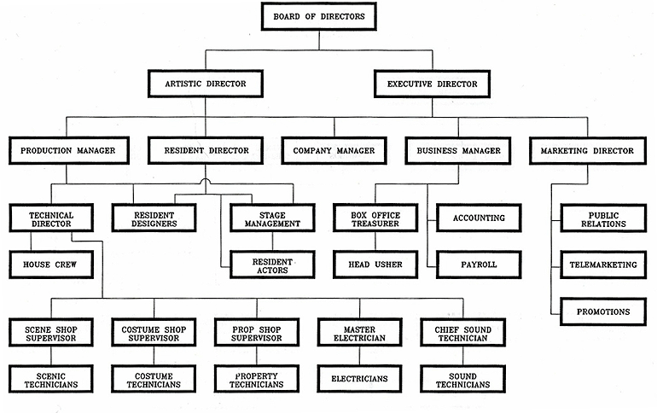

Slide 4
Board of directors
Elected members that are required to be knowledgeable about the workings of the organization to be answerable for its actions, yet able to stand back from the day-to-day management of the organization and retain an objective, longer-term view
Establishing vision, mission and values
Setting strategy and structure
Delegating to management
Exercising accountability

Slide 5
Artistic director
The individual responsible for the major artistic decisions of a theatrical production company
Determine the overall style or tone for each production
Hires production personnel
Select’s the season

Slide 6
Executive director
The executive director is responsible for the overall business, administrative, and operational management of the company
Sees that the organization achieves its financial vision, mission and long term goals
Manages marketing/communications, finance, and organization development
Coordinates volunteer growth

Slide 7
Production manager
The production manager coordinates the production scheduling and administrative/logistical details of a multi-show theatrical season
Responsible for ensuring that all aspects of the production are completed within budget
Oversees and coordinates all aspects of physical production and the production process
Hires and schedules crew members

Slide 8
Resident director
A resident director is a staff member who’s job is to maintain overall artistic quality of the production by working closely with the Resident Dance Supervisor, Music Director and Stage Management team
Responsible for maintaining the artistic integrity of a show
Ensures the quality and completeness of theatre production
Gives notes to the entire cast and rehearses principals and understudies on an ongoing basis
Attends production meetings and technical rehearsals as needed
Insight from Kasey Graham - Resident director on The Phantom of the Opera national tour 2016

Slide 9
Company manager
The company manger is responsible for the logistical and administrative operations of a theatrical production, including payroll, contract negotiation, lodging, transport, scheduling, and interdepartmental communications
Responsible taking care of personnel, including actors, musicians and production staff
Oversees contract negotiations, arranging travel and lodging and making sure that everyone gets paid

Slide 10
Business manager
Business managers control the financial resources of a theater company by implementing a general budget for the organization
Responsible for investigating and reducing major expenses
Distributes payroll and reimbursement to employees
Approves all purchases on the organization's behalf

Slide 11
Marketing director
The marketing director in charge of the promotion and representation of the production, public image, and branding of the theatre organization or show
Main goal is to promote the sale of tickets
Manages all aspects of the theatre’s publicity and advertising material including the show’s website and social channels; TV, digital, and radio ads; fliers, posters, and other printed materials; promotion of press features, and events

Slide 12
Technical director
The technical director is a resident technical expert who supervises the activities of all technical departments
Oversees the technical assets of the theatre, including supervising the use of lighting, sound, communications equipment, and the use and maintenance of stage facilities
Advises production managers, lighting and sound designers, on the technical specifications, costs and usage of technical equipment required for the individual show, and supervises the implementations of approved technical designs
Supervises and assists with set and stage construction and management

Slide 13
Technical director
The technical director is a resident technical expert who supervises the activities of all technical departments
Oversees the technical assets of the theatre, including supervising the use of lighting, sound, communications equipment, and the use and maintenance of stage facilities
Advises production managers, lighting and sound designers, on the technical specifications, costs and usage of technical equipment required for the individual show, and supervises the implementations of approved technical designs
Supervises and assists with set and stage construction and management

Slide 14
Resident designer(s)
A member of the company’s staff who is head of a creative area(s) contributing to style and theme of a production
Could be responsible for designing sets, lights, sound, projections or costumes for one or all theatre productions
Primary duties include provision of supporting design paperwork, such as costume thumbnails and renderings, costume lists and charts, white and painted models, and set ground plans and elevations

Slide 15
Stage manager
A Stage Manager supports and organizes all the different teams involved in the running of a theatre production from rehearsals to the last performance
Facilitate communication across all creative and technical departments
Create and set-up rehearsal schedules
Create a prompt script compiled with notes on Actors’ cues and requirements for props, lighting and sound
Manage the backstage and onstage area during performances

Slide 16
Box office treasurer
The box office manager supervise ticketing operations for venues as assigned with the dual goals of providing a high level of customer service and maintaining accuracy and efficiency
Sets up events in ticketing system
Works with theater managers and company managers to fulfill policy and contractual agreements as well as helping to ensure smooth front of house operation
Works with promoters on setup and sales of their events

Slide 17
Accounting head
The Accounting head will assist in the management of finance and accounting operations
Track, deposit and verify all income from all sources, including donations, ticket sales and rentals
Prepare and verify, with appropriate department heads, all tax reports and/or forms for admissions tax, sales and use tax, & food and beverage tax
Follow up on older uncashed checks with vendors and/or individuals
Cut checks on a weekly basis from appropriate checking account
*Generally the same roll as other accountants but with an arts background

Slide 18
Public relations
The public relations manager will serve as the publicist and take the lead role in promoting organizational visibility and institutional messaging
Will serve as lead editor and proofreader of major company publications
Develops and implement public relations campaigns for theater company
Coordinates interviews, managing media notices, securing biographies and headshots, acting as media liaison for internal video and photo shoots

Slide 19
House crew (run crew)
The run crew are the crew members that power the scene changes, prop handoffs and onstage “magic” for each production
Moves scenic units operates flying scenery
Strikes and sets up of props on stage
Operates lighting and/or sound systems

Slide 20
Resident actor
The resident actor is a member of the acting company ( collection of performers) they are employed by the theater company to perform in one or all productions in a season
Memorizes lines, blocking and choreography
May be responsible for understudying other roles
May have additional responsibilities such as dance captain or fight captain

Slide 21
Head Usher
Supervises and coordinates activities of all ushers at entertainment events and directs patrons to area of seat location
Responsible for confronting and possibly removing disruptive audience members
Has a thorough understanding of the seating and navigation of a venue
Provides additional attention to patrons with additional mobility needs
Maintains professional decorum

Slide 22
Payroll
Under direct supervision of the business manager, and accounting head, a payroll clerk will perform duties within the payroll, human resources, and accounting departments
Review time reports for accuracy and completeness
Compile payroll data such as, but not limited to garnishments, vacation time, and insurance
Adjusts timecard entries as necessary
Responds to employee inquiries in timely manner regarding payroll and benefits information and trouble-shoots to resolve employee payroll and benefits concerns
Update and maintain employee file, payroll, and benefit records

Slide 23
Telemarketing
A telemarketing agent is responsible for reaching out to current and future patrons via telephone in the efforts to solicit additional business or interest.
Efficiently placing calls to patrons
Logging patron responses
Closing Subscription sales

Slide 24
Promotions
A promotions specialist coordinates activities to promote theater productions; assists in the design and production of promotional materials, publicity and advertising
Collaborates with theater production staff to develop publicity campaigns to promote upcoming events
Produces radio, television, newspaper, and internet promotional material
Uses computer graphics and software programs to design and produce promotional materials such as flyers, brochures, posters, and internet ads
Works with theater box office to coordinate special promotions and manage ticket availability

Slide 25
Shop supervisor(s)
A shop supervisor oversees a technical area and is responsible fore the duties of that area. Additionally, the supervisor manages and coordinates the technicians and assistants assigned to their area
Areas that require supervisors:
Scene shop
Costume shop
Props shop
Electrics (master electrician)
Sound (lead sound tech.)
Video - often a part of electrics
Pyro

