Slide 1
Principles of Theater Practices
Module 1 – The Physical Stage

Slide 2
In order to understand the modern stage we must first look back to how it originated
A brief history lesson

Slide 3
Ancient Greek Theater
Greek theaters originally constructed between 320 – 100 B.C.E.
Outdoors/open air
Made of wood and stone
Popularity of theater driven by religion

Slide 4
The Theater of Dionysus

Slide 5
Terminology
Orchestra: Normally circular, dancing space for chorus performers
Theatron: Seating area/viewing area
Skene: building behind the stage that acted much like a backdrop
Parodos: Plural = parodoi and were the paths used by chorus members and actors for entrances/exits

Slide 6
Automation in Greek theater?
Greek theater had some special effects, by no means as technical as todays theaters/performances but cutting edge for its time
Mechane: A wooden crane like mechanism that essentially could fly people useful since performances revolved around gods
Ekkyklema: A slip stage of sorts, on wheels often used to roll out people
Periaktoi: 3 sided flats that can be rotated to reveal different scenery

Slide 7
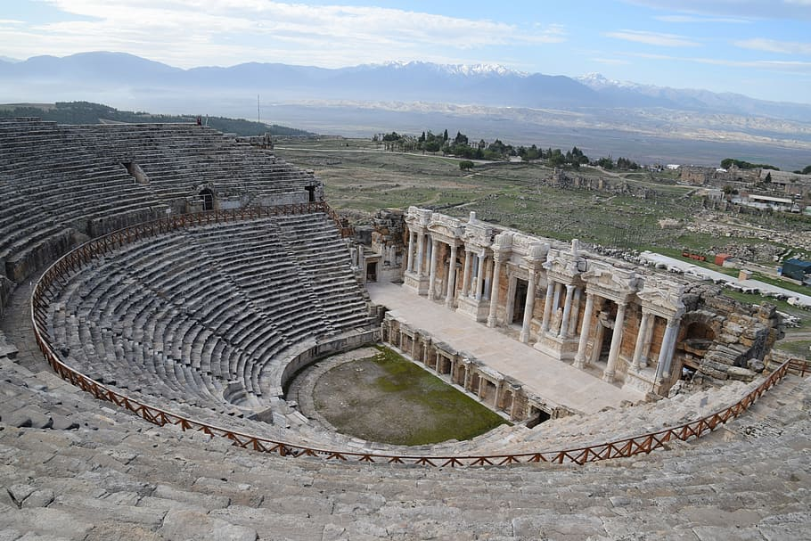
Roman Theater
Roman theaters originally constructed between 240 – 100 B.C.E.

Slide 8
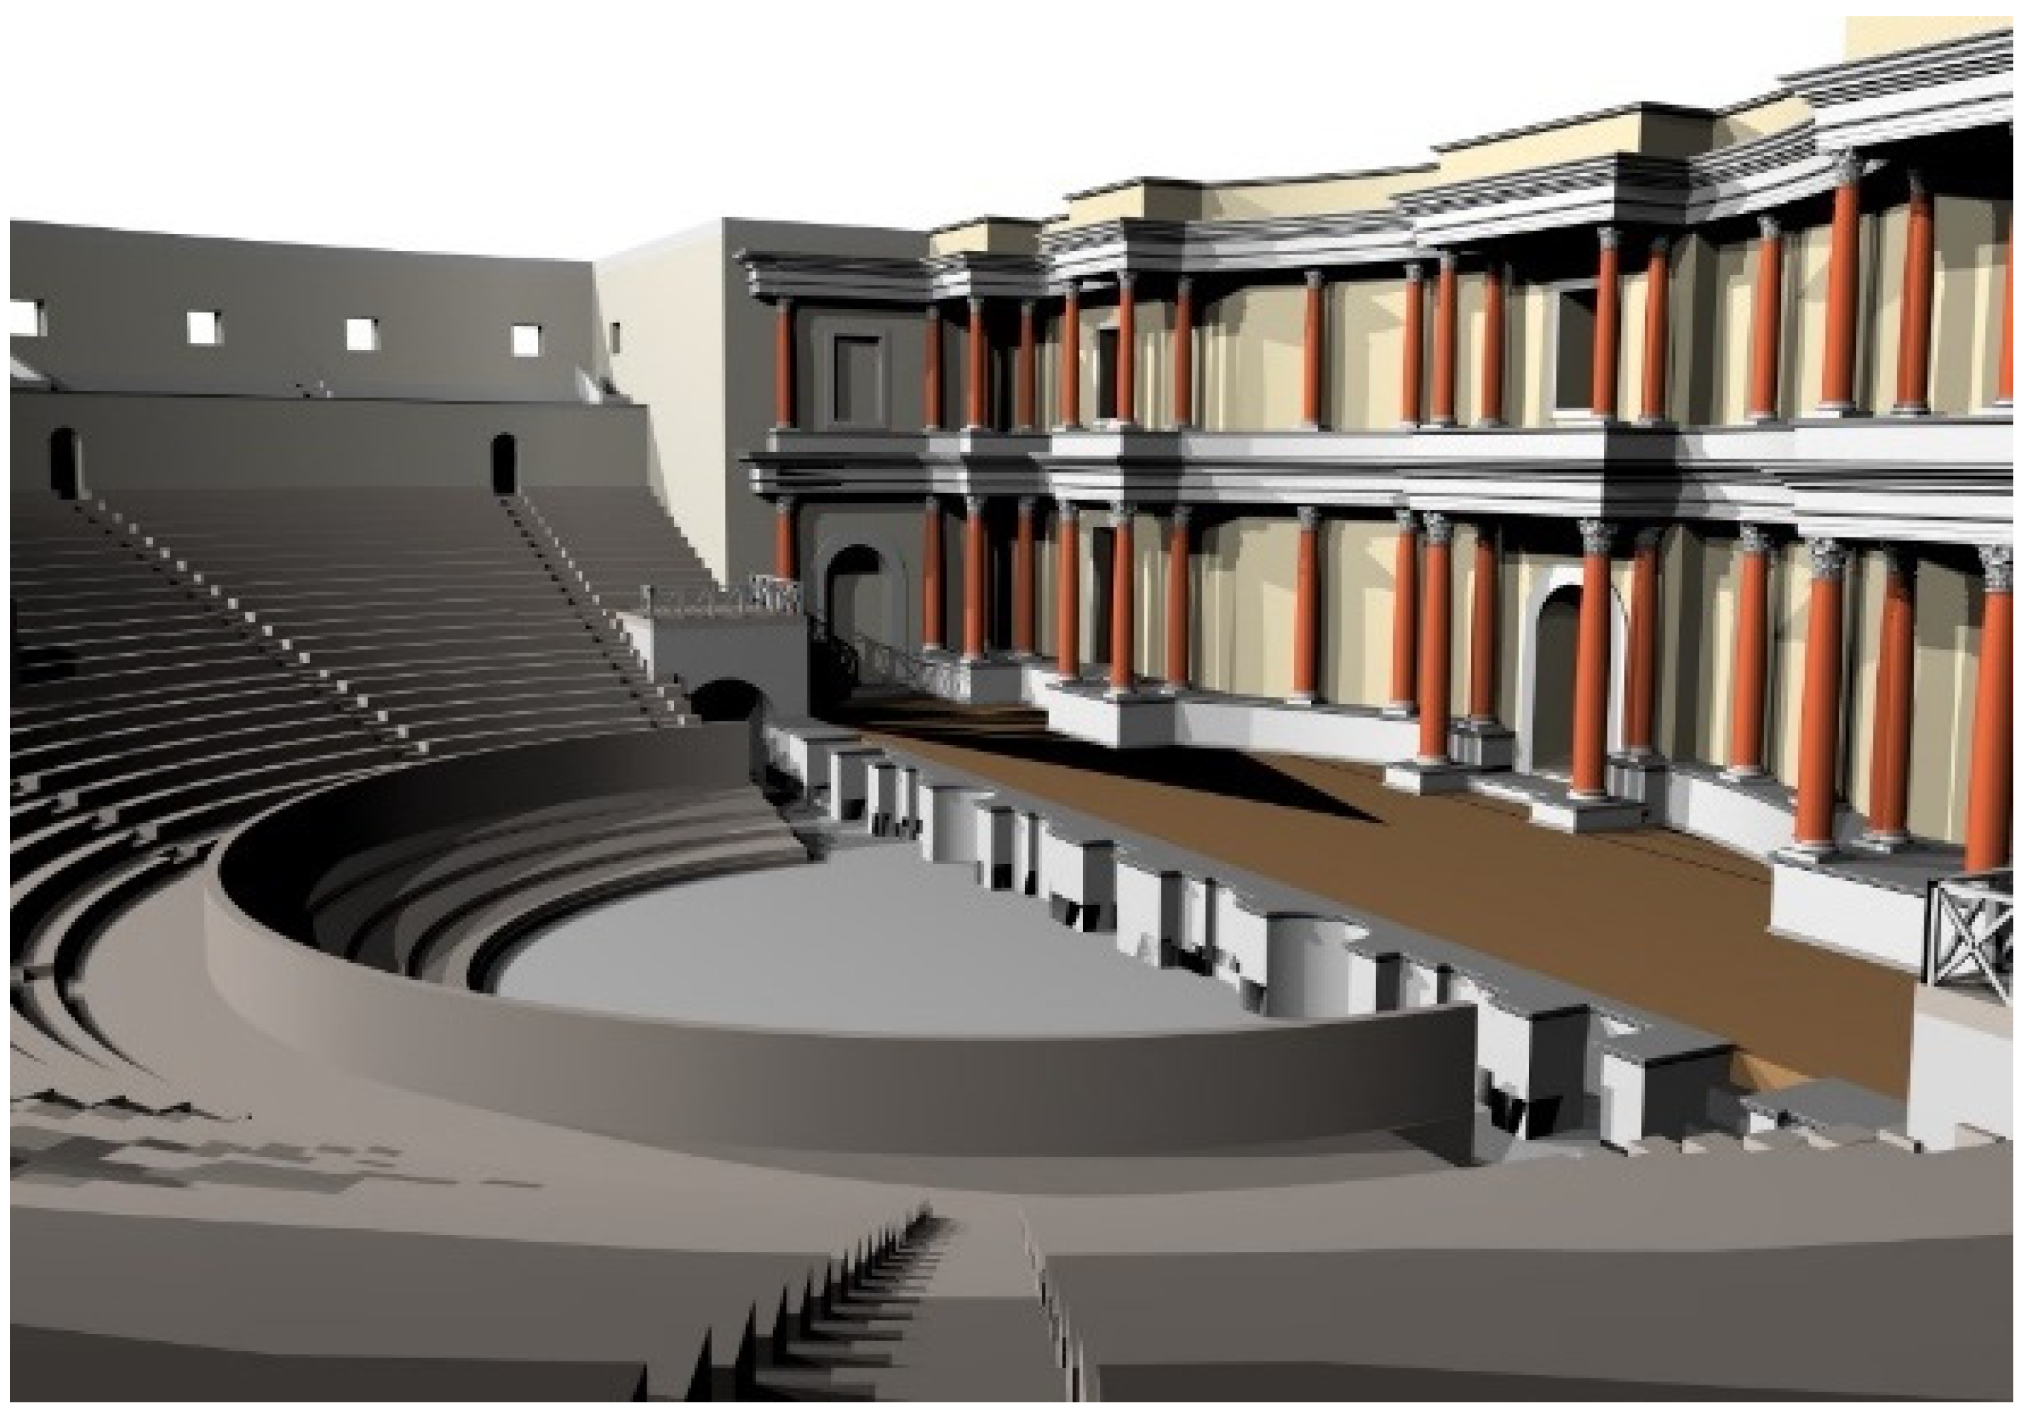
The Theater of Hierapolis

Slide 9
Terminology
Proskenion: The faced in front of the scene or skene
Kerkis: Seating area for audience
Diazoma: Curved walkways
Alter: Used for sacrifices to roman gods, not used in performances but as a focal point (think scenery)

Slide 10
What are some of the differences between Greek and Roman theater
Greek theaters were carved into the land where Roman theaters were build up
Greek theaters had a smaller orchestra where as Roman theaters’ orchestras were larger due to the need to be more multi-purpose
Sometimes would flood them and do boat battle scenes

Slide 11
Early Asian Theater
Sanskrit drama was the beginning of Asian theater 200 B.C.E. – 600 C.E.
Much of the performance was in courts (on ground level outside)
The first professional theater companies formed in China 960 C.E.
Noh theater developed in 1363 – 1444 C.E.
Kabuki theater becomes popular 1675 – 1750 C.E.
Bunraku theater formed in Japan 1685 C.E. (puppet theater)

Slide 12
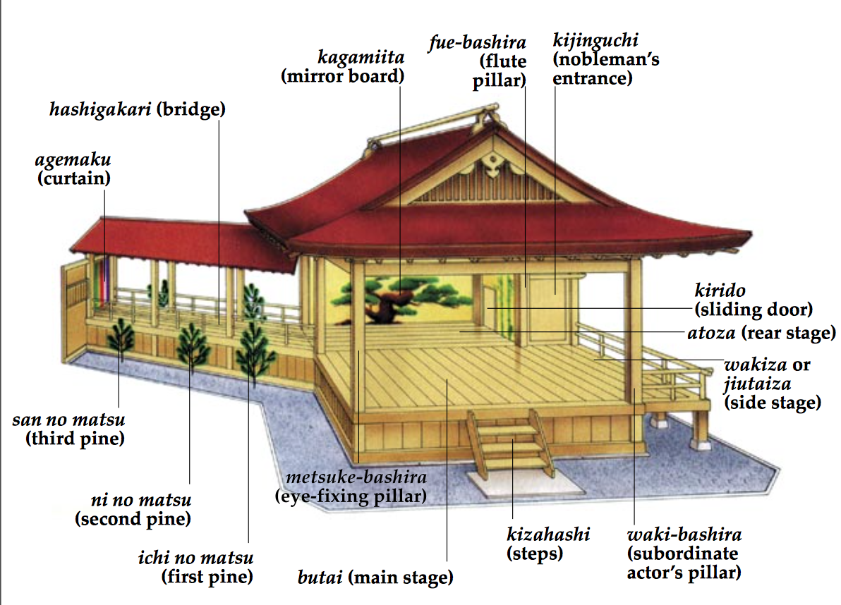
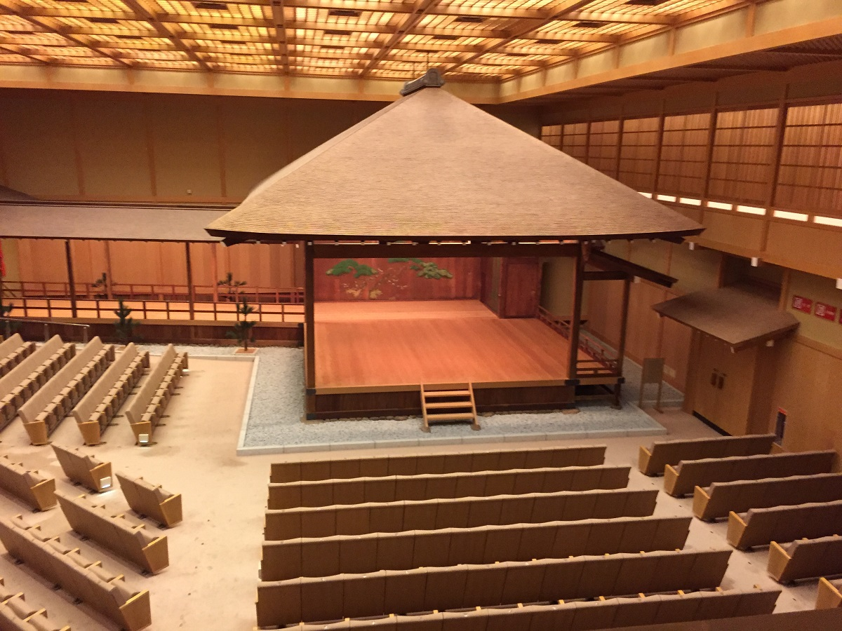
Noh Theater

Slide 13
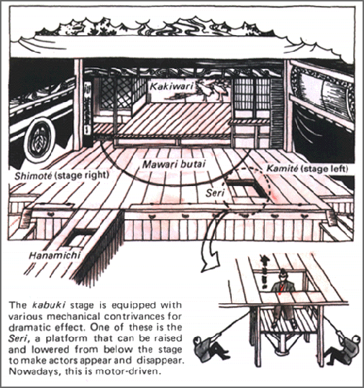
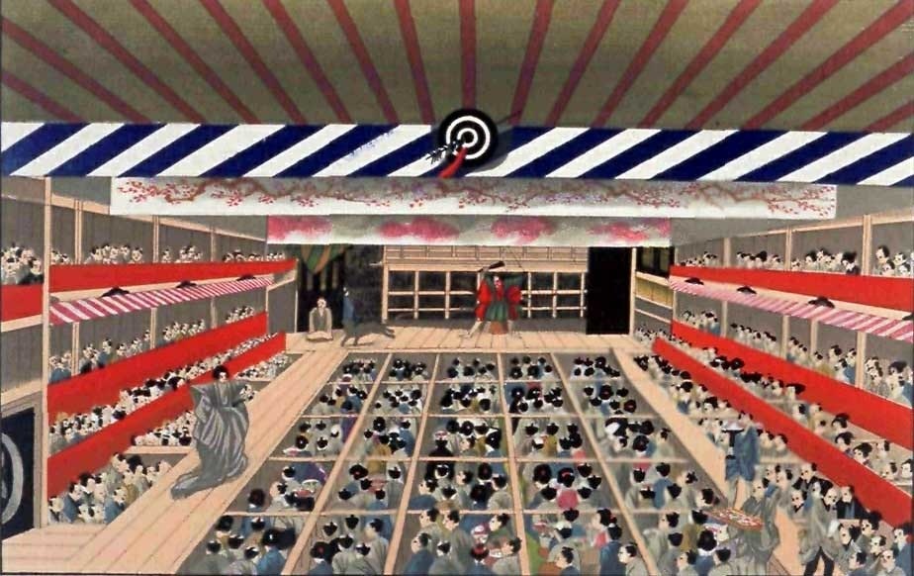
Kabuki Theater
Introduction of trap doors and elevators

Slide 14
Medieval Theater
Originated from 400 – 1400 C.E. in European countries
3 types of performance Mystery Play, Miracle Play, and the Morality Play
Introduction to portable stages and elevated platforms (pageant wagons)

Slide 15
Mystery cycles performed in churches

Slide 16
French Theater
Tennis court theater 1600 C.E.
Adapted from tennis courts
Different viewing experience, where you could see other audience members

Slide 17
Shakespeare’s time
English renaissance theater 1558 – 1642
Fixed structure for performance. The heavens, inner above and inner below
Provided levels
Also - introduction of the pit

Slide 18
Globe Theater

