Slide 1
Principles of Theater Practices
Module 11 – Stage Technician Decorum

Slide 2
Who determines when we should show up?
Stage managers communicate with the director to determine time
Union Stewards work with Production Managers to determine time
Can be fined $20 if show up late or $80 for a No-show
These are non-negotiable!
You either can or can’t make the call
Don’t ask to arrive later or leave early
Union operates with 4-hour minimums

Slide 3
Definitions for time
Call time
Technician and Actor calls can be different
Remember to sign in
Show time – When do you start the show
Curtain – meaning when the curtain is raising to start the show
Run time is average length of time for the show to happen
So… When should I show up?
Ideally 15 minutes before call time
No less than 5 minutes before call time

Slide 4
Tools of the trade – at FSCJ
Load in / Strike
Adjustable wrench
Gloves
While in Tech / Running a show
Multi-tool
Flashlight
Pocket knife (blade 3” or smaller)

Slide 5
Tools of the trade - Union
Hammer | Pliers
Adjustable Wrench | Pencils and Pens
Tape Measure 25’ | JT-21 Staple Gun
Utility knife | Phillips and Flat blade Screwdrivers
Pry Bar | Wire cutters (diagonal)
Metric Allen Wrench set | Standard Allen Wrench set
Hardhat (ANSII Approved) | Toolbelt or Nail Apron
¼” Ratchet Set (No Larger) with 5mm Hex and Torx 30 tips
http://www.iatse-115.com/?zone=/unionactive/view_article.cfm&HomeID=449907&page=Active20Stagehands

Slide 6
Tools of the trade – Union Additional
Set decorating calls
Top carpet cutter or Loop pile cutter
Journeyman calls – Usually means carpentry call
Cordless screw gun with bits
http://www.iatse-115.com/?zone=/unionactive/view_article.cfm&HomeID=449907&page=Active20Stagehands

Slide 7
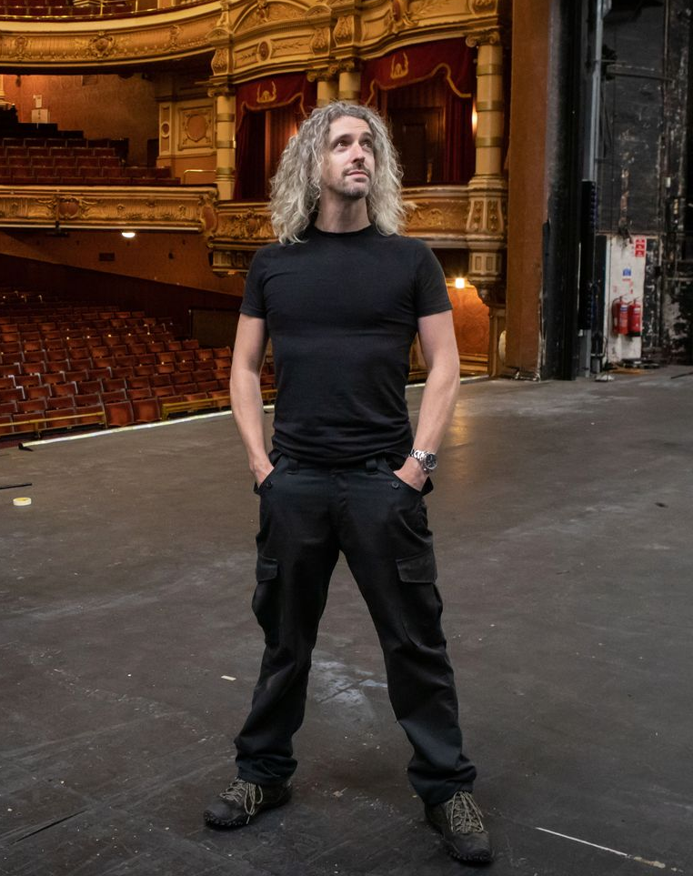
Clothing expectations For shows
Black T-Shirt
Black Pants
Outdoor events black shorts OK
Black Shoes
Boots or sneakers
Unique circumstances – Full Ninja
Black long sleave shirt
Black gloves
Black head covering

Slide 8
Expectations during show
DO YOUR JOB!
You are part of a team and others are depending on you
Be where you are supposed to be, when you are supposed to be there
Be aware and attentive
Technicians are often called upon if something goes wrong
STAY OFF YOUR PHONE!
If an issue, stage management may collect devices before show and return after
$20 fine for phone misuse on Union calls and can be asked to leave
Be quiet

Slide 9
Headset communications
Warning
You have a cue coming up soon
Stand by
Get read to do your cue
GO
Fire the cue or perform the action
If needing to go off headset
Ask if you can go off headset - Stage manager knows if it is a good time
“Your Name going off headset” or “Your Name back on headset”
We can get chatty on headset – SM may ask “Quiet on coms”

